Slide 1




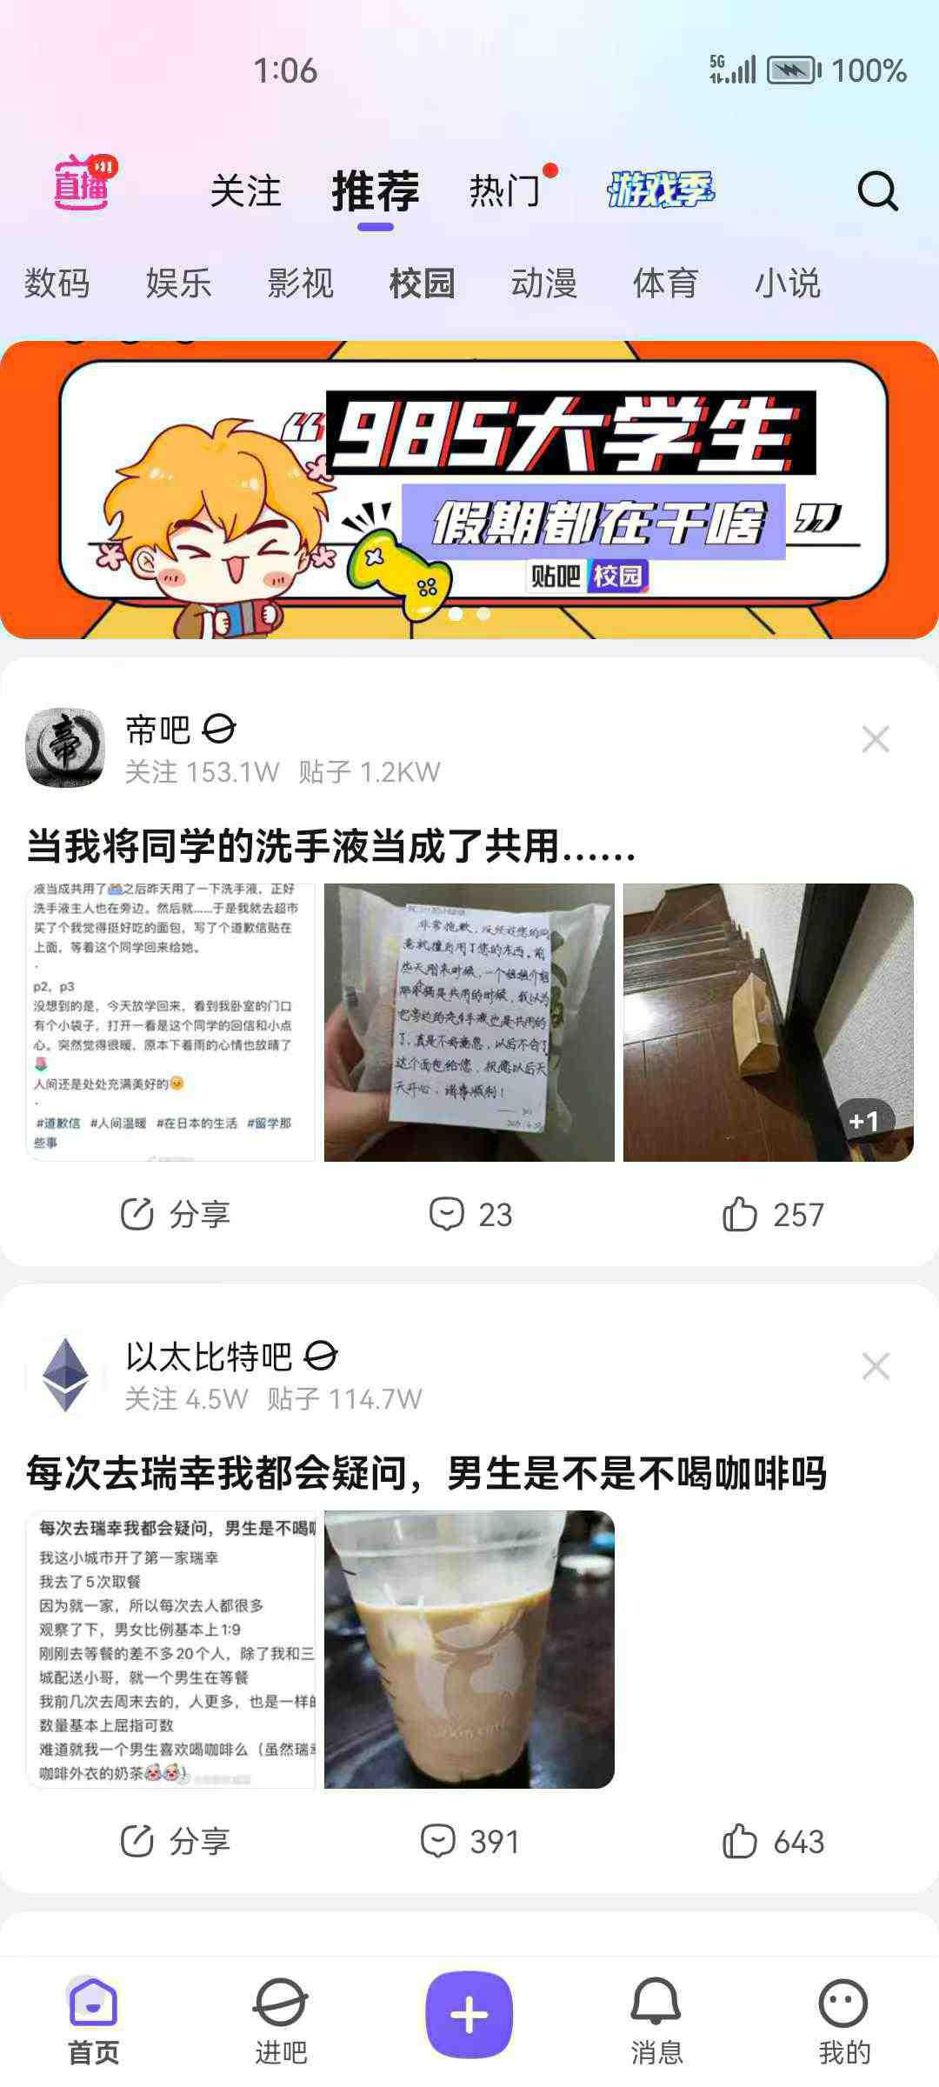
Ask
Search
Answer
Play

Slide 3
High degree of openness, wide range of audiences
Invalid information overload
Lack of pertinence

Slide 4

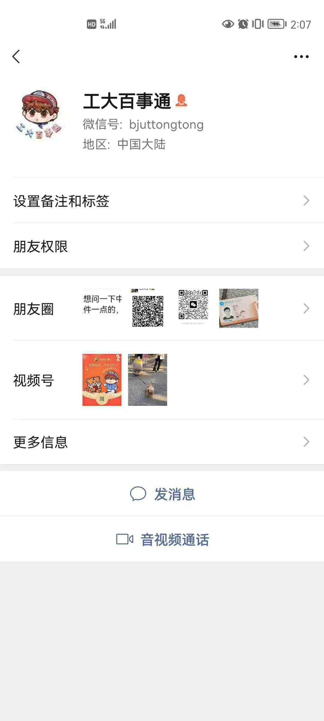

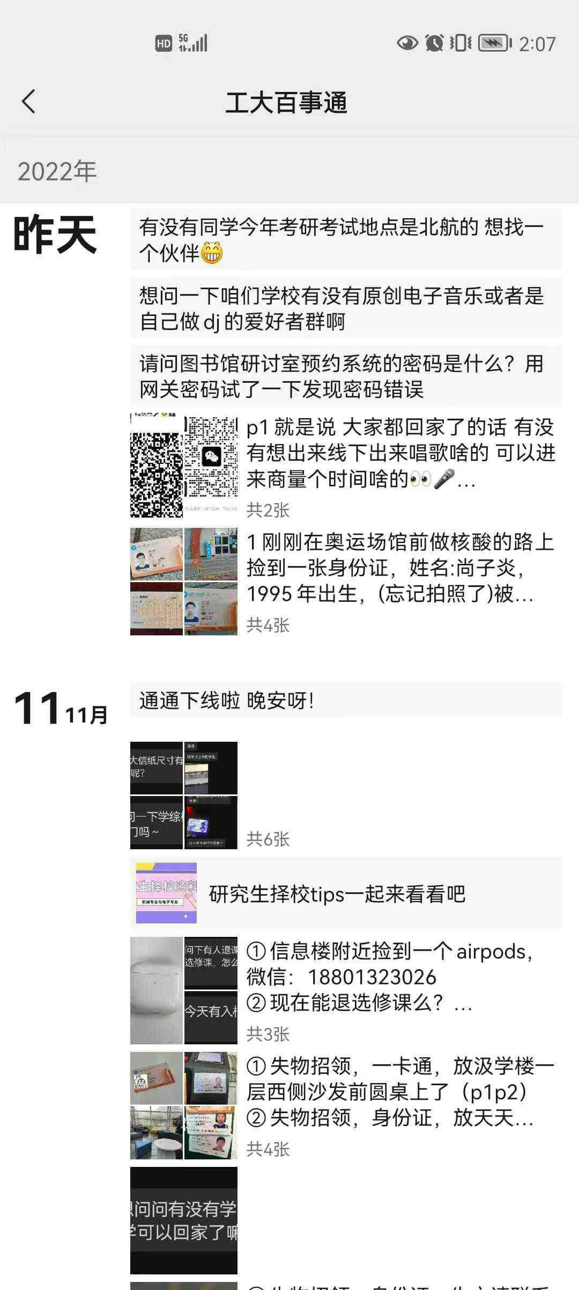
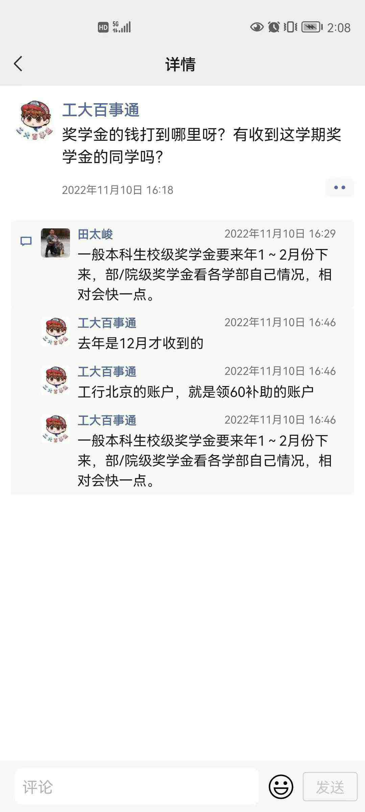
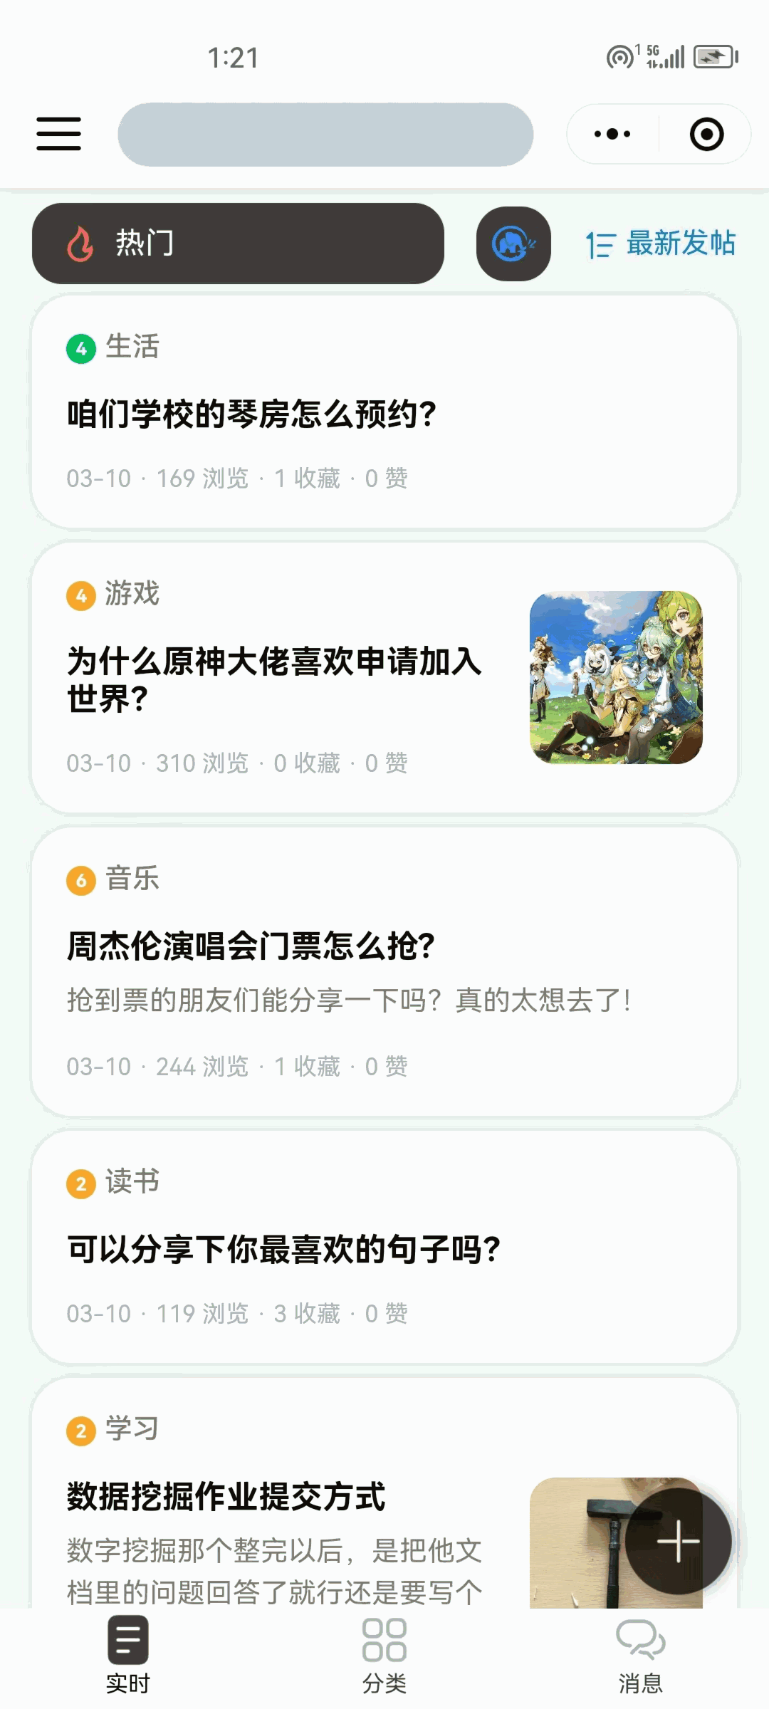
High degree of openness, wide range of audiences
Invalid information overload
Lack of pertinence
减法
“微”，体量小
精简界面，突出有效信息
缩小范围，专注大学生

Slide 5
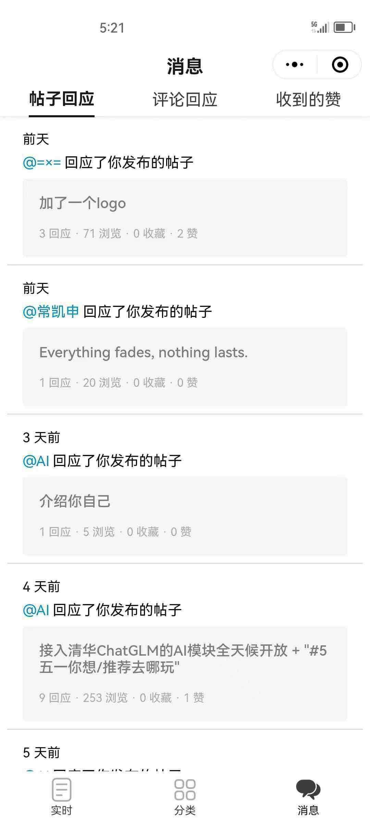
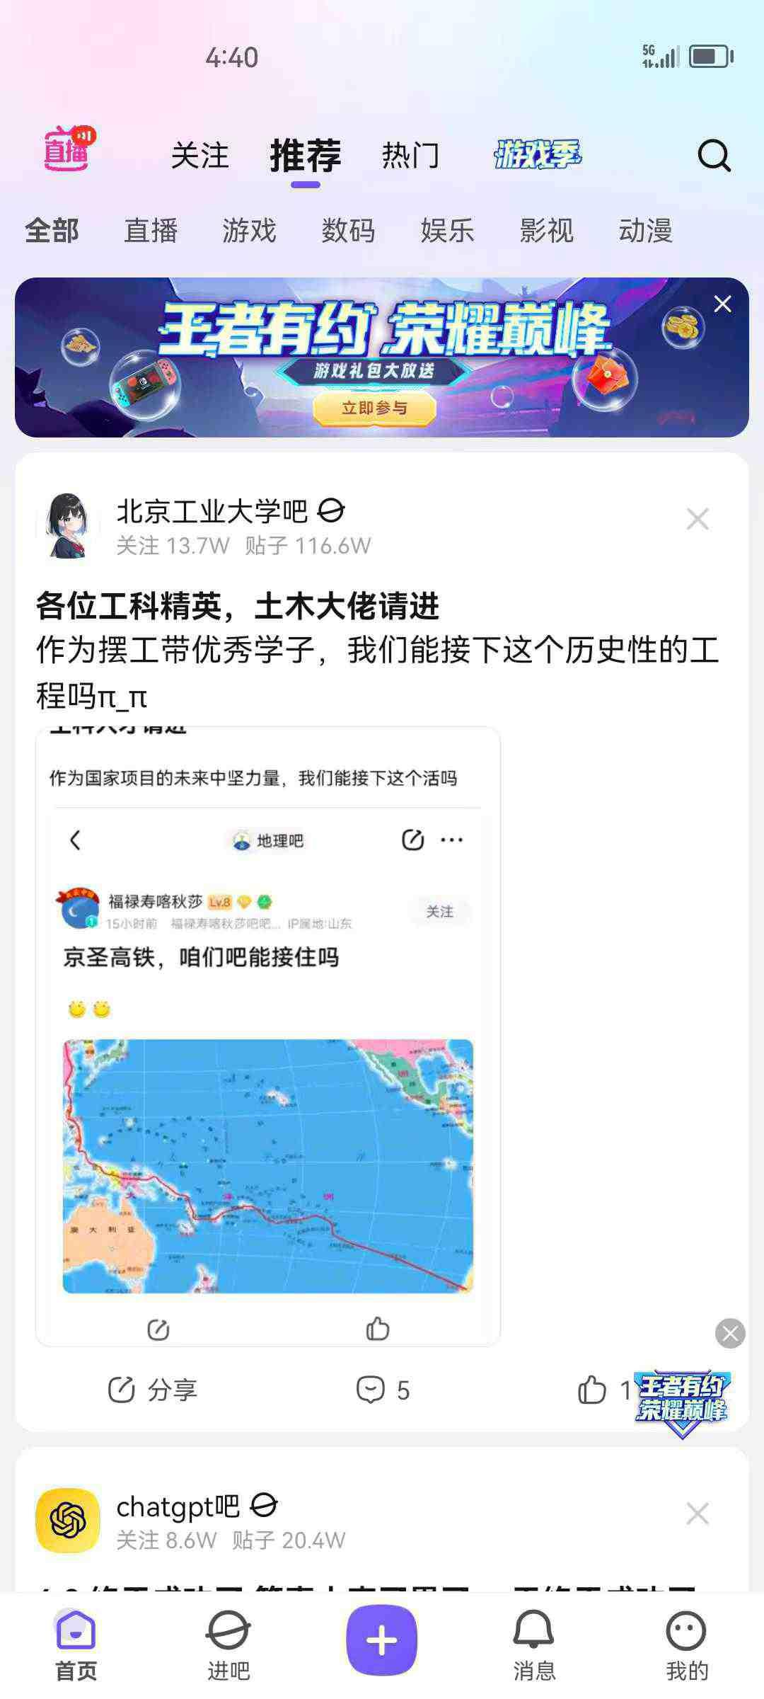
消耗人力资源
信息相对闭塞
用户操作有限

Slide 6
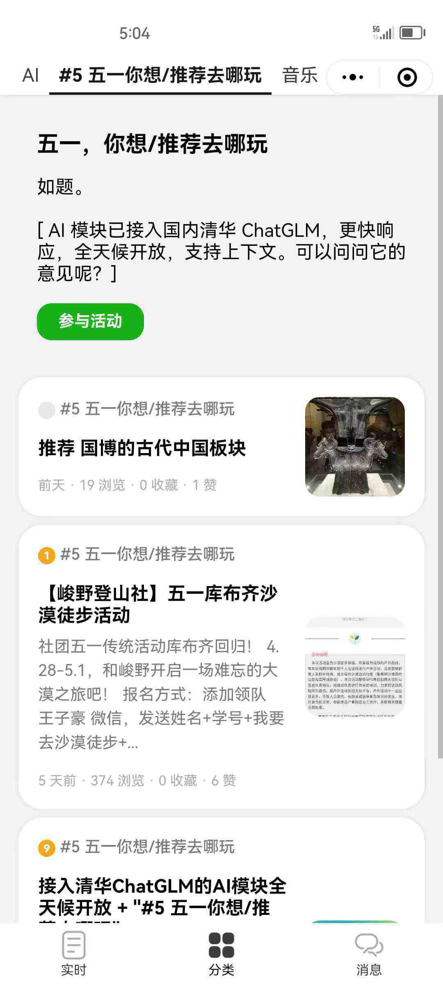
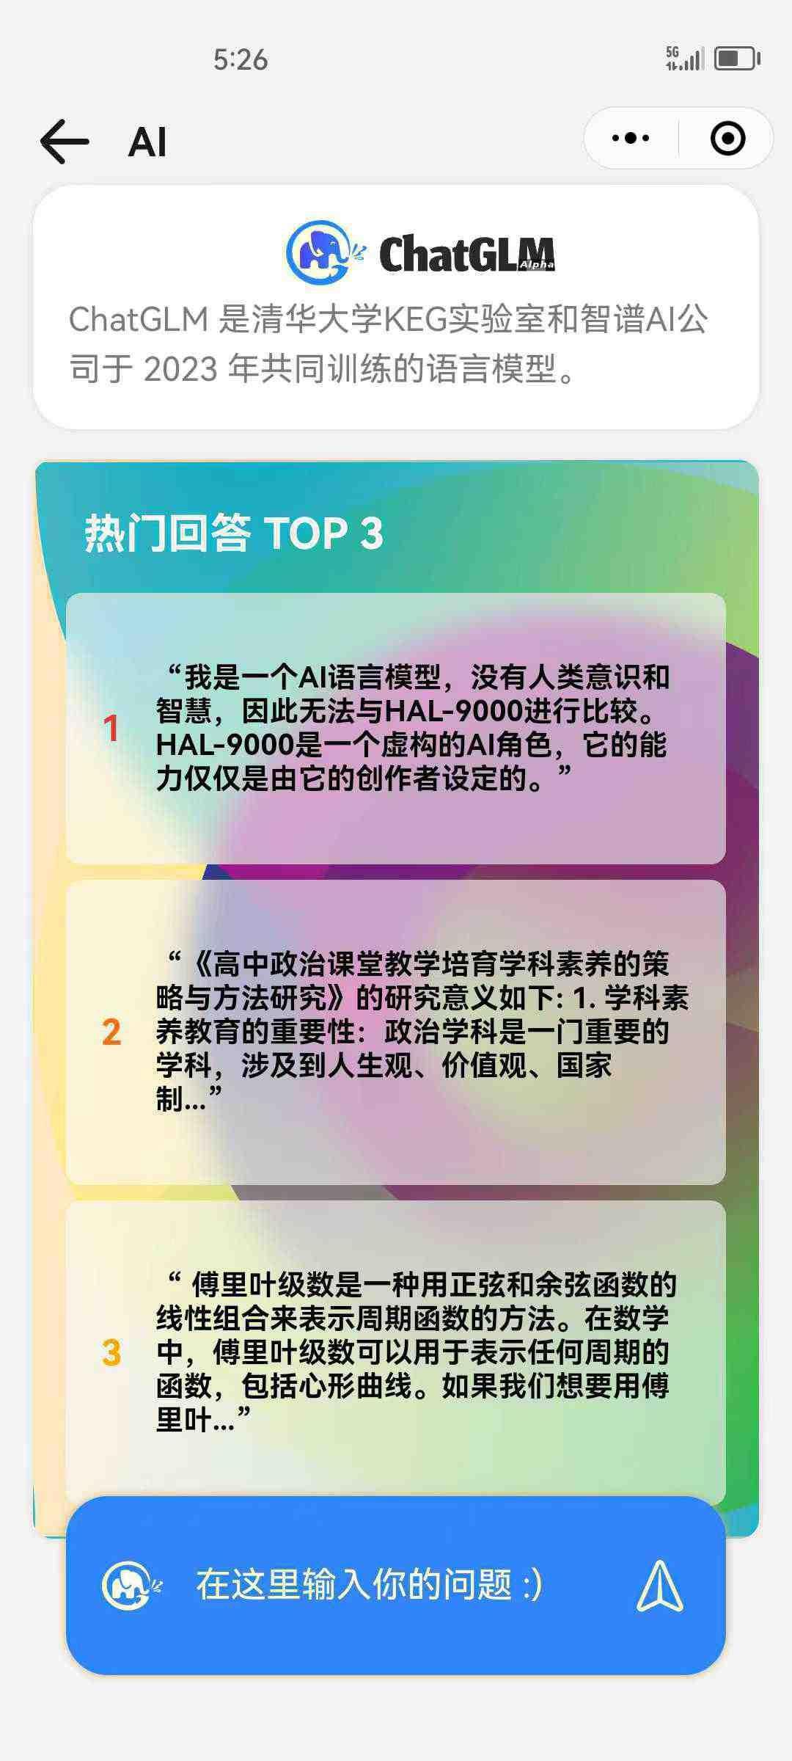
消耗人力资源
信息相对闭塞
用户操作有限
加法
提供多功能模块
提高自由度和自主性

Slide 7
Ask
Search
Answer
Play
Where do you want/recommend to have fun in the May Day Holidays?
Music
Message
Latest
Posts
Where do you want/recommend to have fun in the May Day Holidays?
Post Reply Comment Reply Likes Received
Hot
Life
Responded to your post
How do I book a piano room in our school
169 Views 1 Collects 0 Likes
Popular Answer TOP 3
Game
Participate
The day before yesterday
Responded to your post
Translation: I'm an AI model with no human consciousness…
Where do you want/recommend to have fun in the May Day Holidays?
310 Views 1 Collects 0 Likes
Music
3 days ago
How to grab the Jay Chou’s concert tickets?
Where do you want/recommend to have fun in the May Day Holidays?
Responded to your post
Responded to your post
Translation: High school political education…
Can anyone who got tickets share with us your experience? I really want to go!
244 Views 1 Collects 0 Likes
Reading
Responded to your post
Translation: Fourier series is a…
119 Views 3 Collects 0 Likes
Study
Where do you want/recommend to have fun in the May Day Holidays?
5 days ago
Enter your question here :)

Slide 8
Ask
Hot
Latest
Posts
Search
Life
How do I book a piano room in our school
169 Views 1 Collects 0 Likes
Game
310 Views 1 Collects 0 Likes
Answer
Music
How to grab the Jay Chou’s concert tickets?
Can anyone who got tickets share with us your experience? I really want to go!
244 Views 1 Collects 0 Likes
Reading
Play
119 Views 3 Collects 0 Likes
Study

Slide 9
Game
Music
How to grab the Jay Chou’s concert tickets?
Ask
Can anyone who got tickets share with us your experience? I really want to go!
Search
Reading
119 Views 3 Collects 0 Likes
Answer
Study
Play

Slide 10
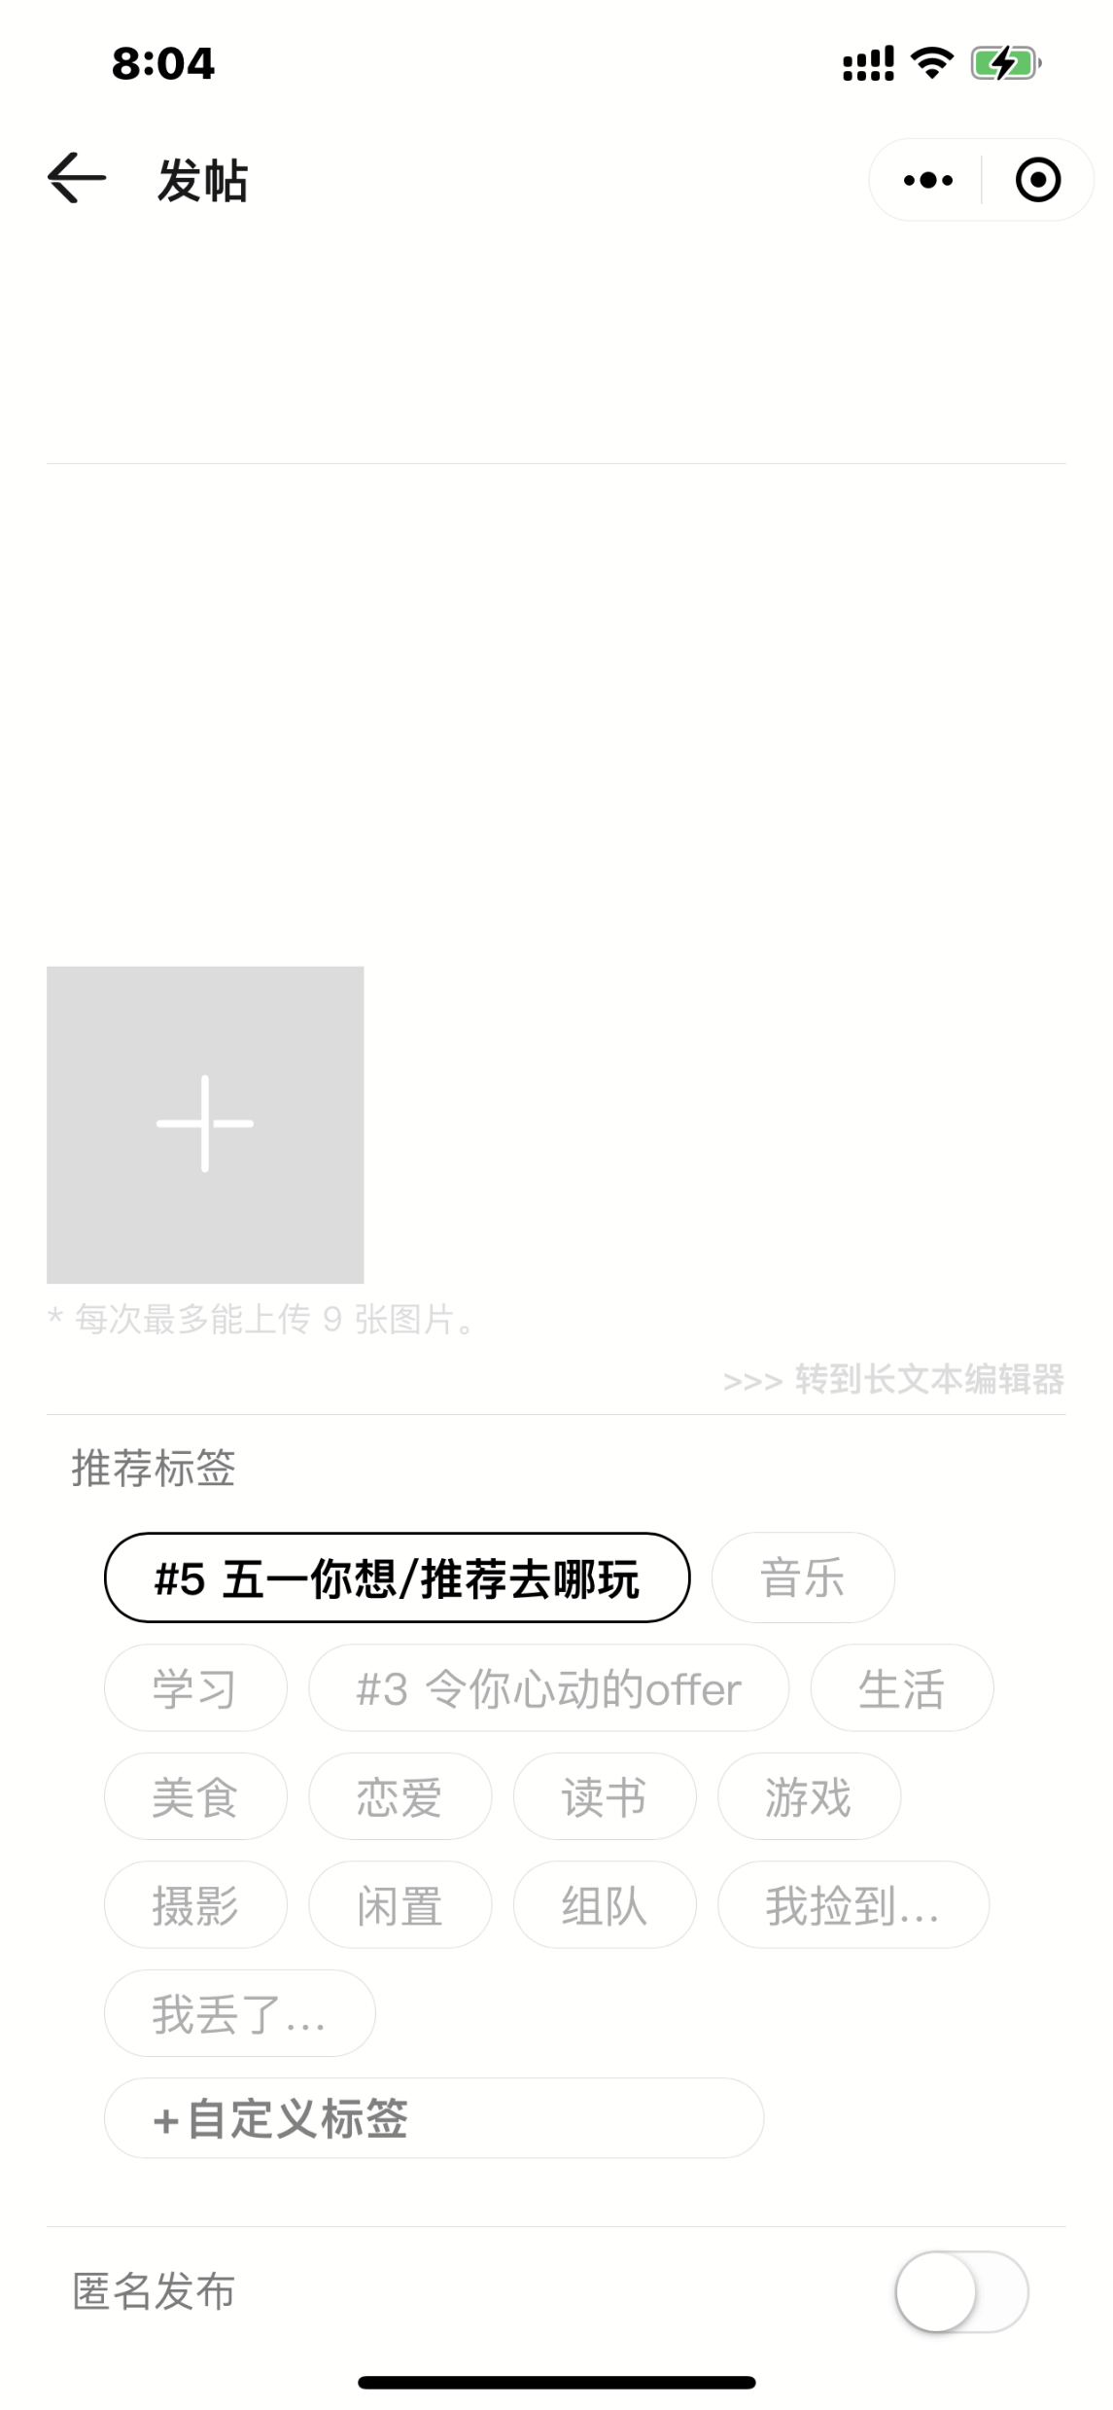
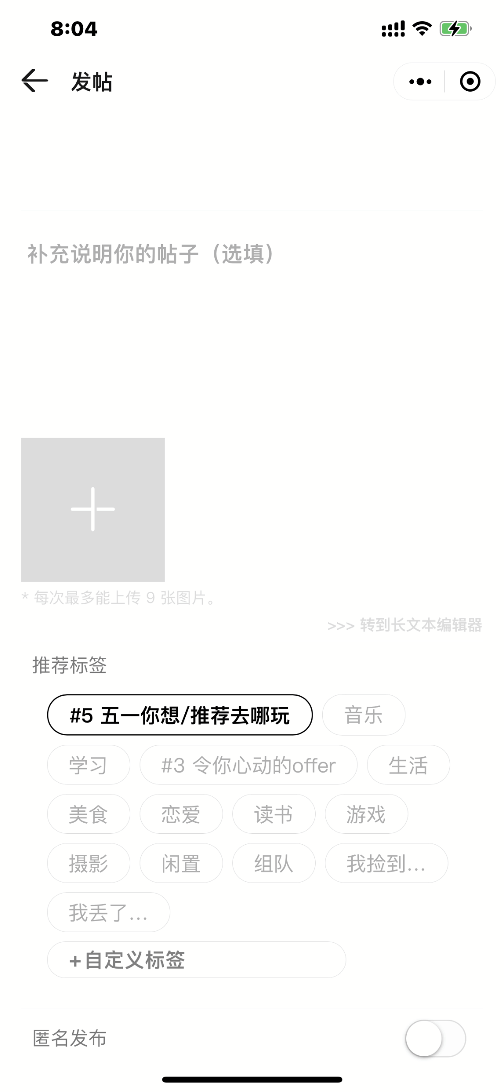
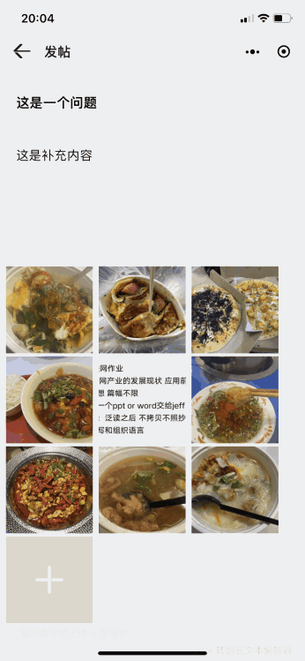

Ask
Post
This is the title
Search
This is additional content
Answer
Recommend Tag
Where do you want/recommend to have fun in the May Day Holidays?
Music
Play
Study
Live
Reading
Game

Slide 11
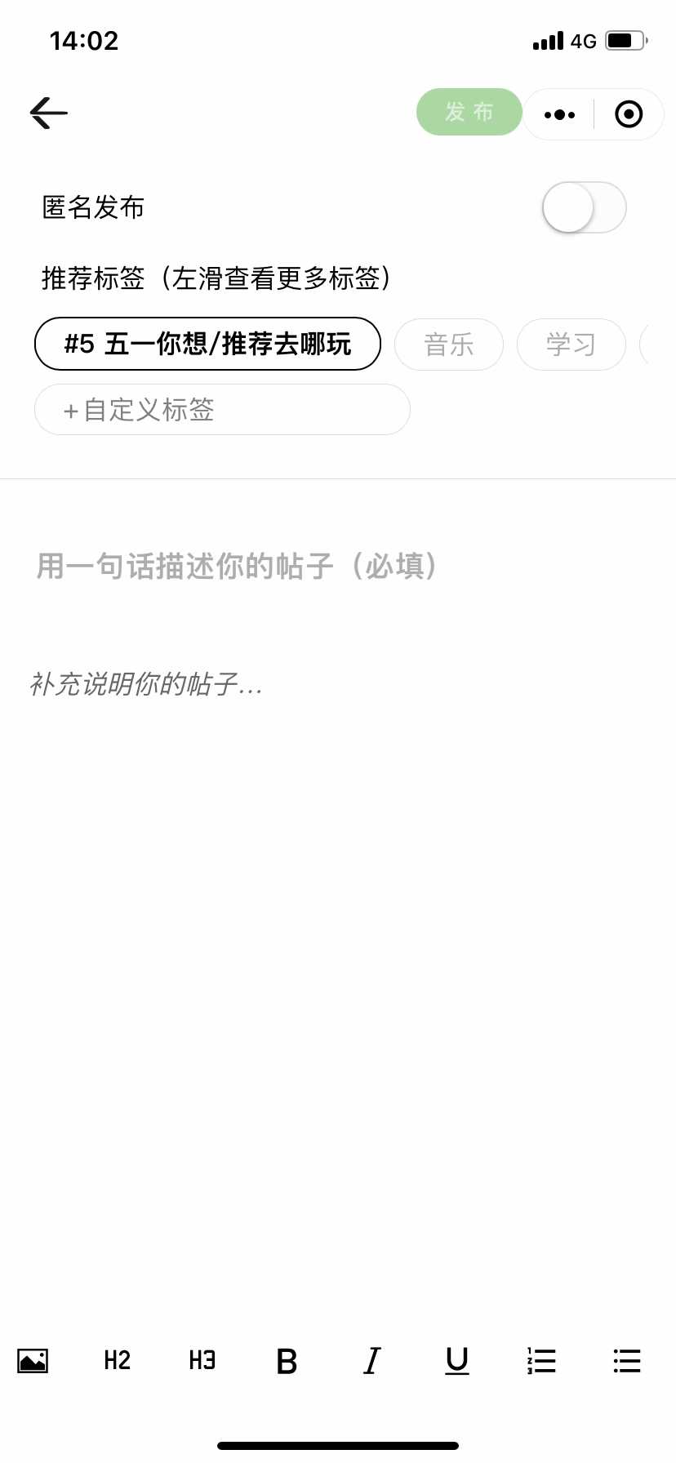
Ask
Describe your post in one sentence (mandatory)
Additional Information
Search
Answer
Play
Rich Text Editing

Slide 12
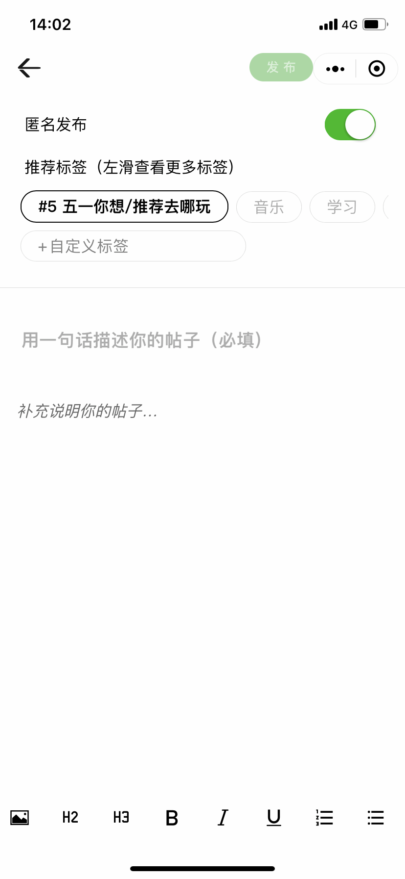

Ask
Search
POST
Anonymous
Posting
Anonymous Posting
Recommend Tag (Left swipe to see more)
Answer
Where do you want/recommend to have fun in the May Day Holidays?
Music
Study
Customize
Play
Describe your post in one sentence (mandatory)
Additional Information

Slide 13
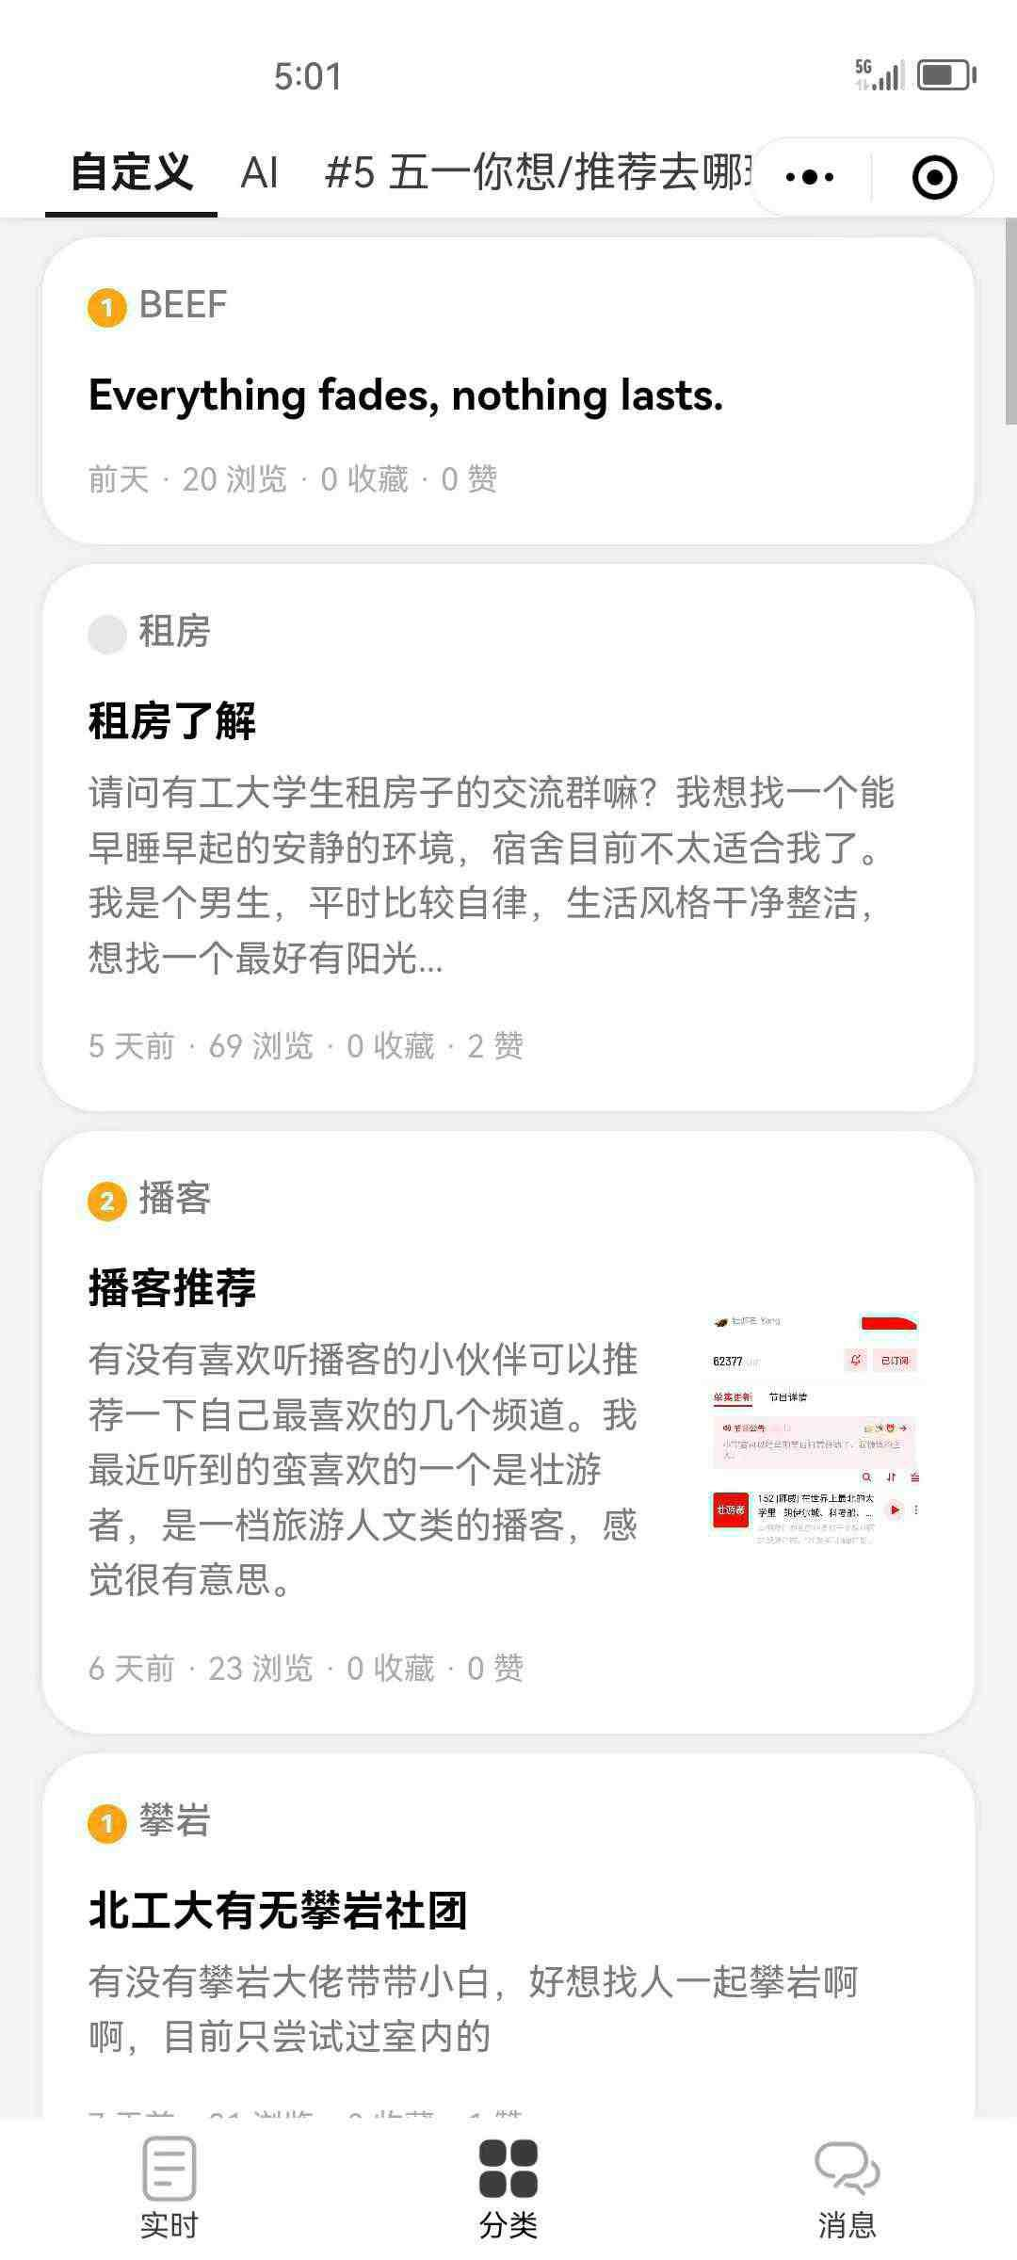
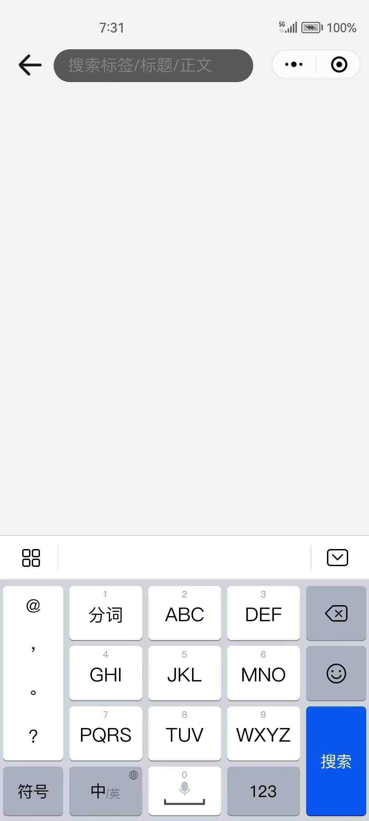
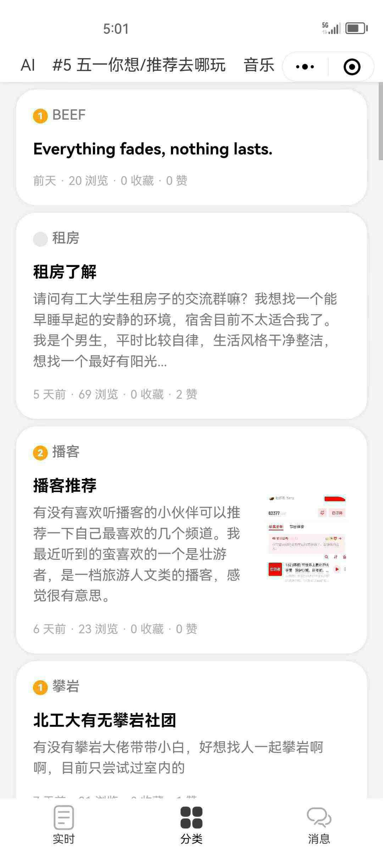
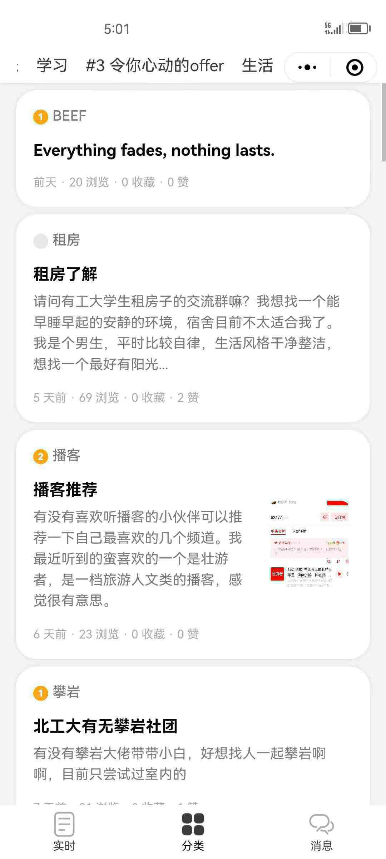


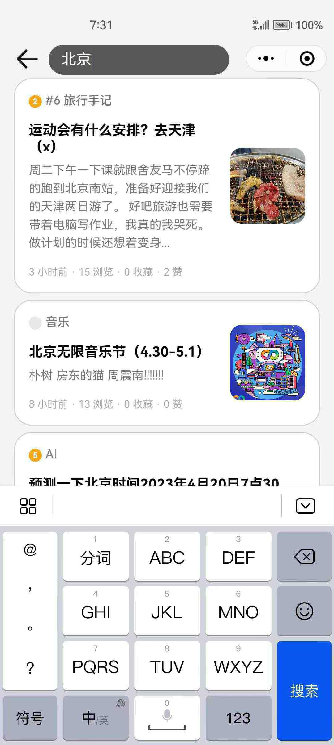
Ask
Customize Tags
Music
#5 Where do you want/recommend to have fun in the May Day Holidays?
By Words
By Tags
Search
Answer
Play

Slide 14
Ask
Search
By Tags
Answer
Play

Slide 15
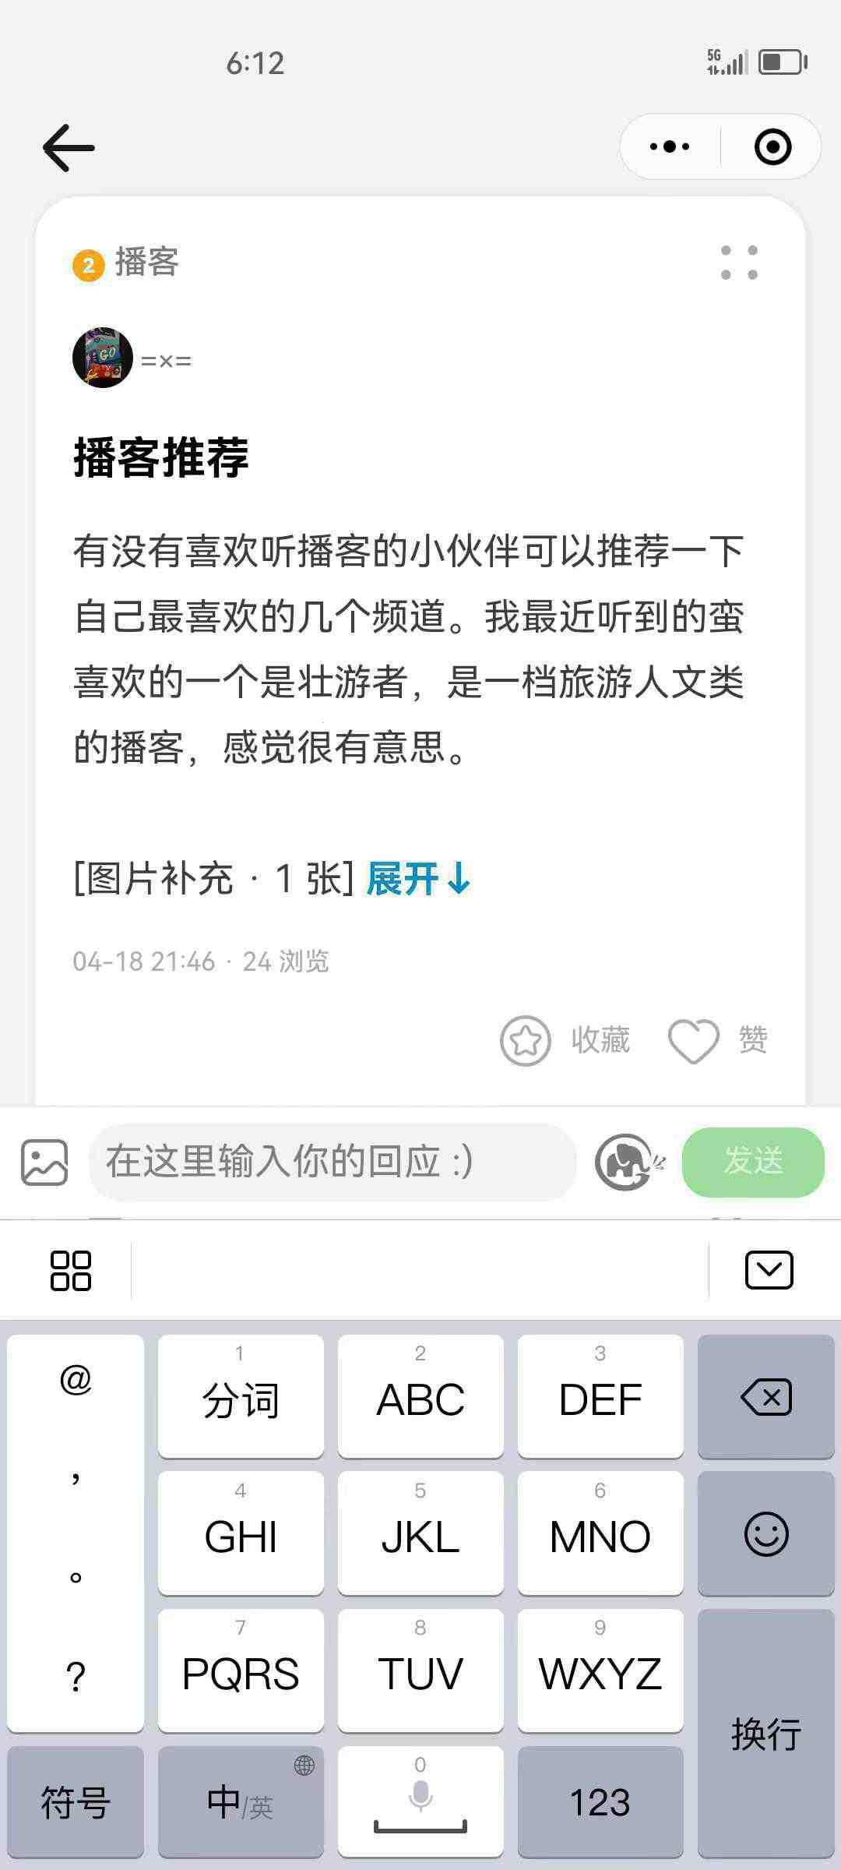
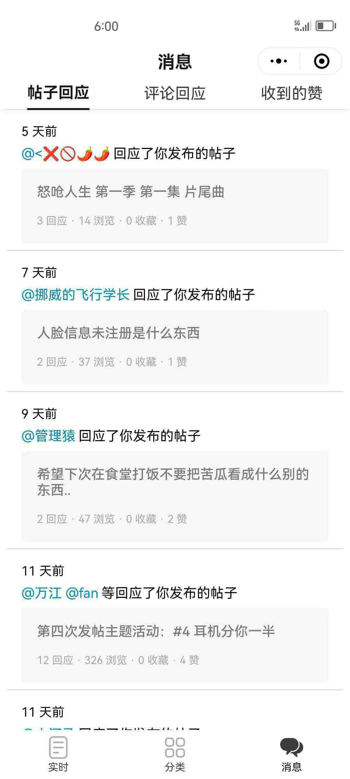
Ask
Message
Post Reply Comment Reply Likes Received
Search
7 days ago
Responded to your post
Quickly Respond
Timely Receipt
Answer
Collect Like
Enter your reply here :)
11 days ago
Play
Responded to your post

Slide 16
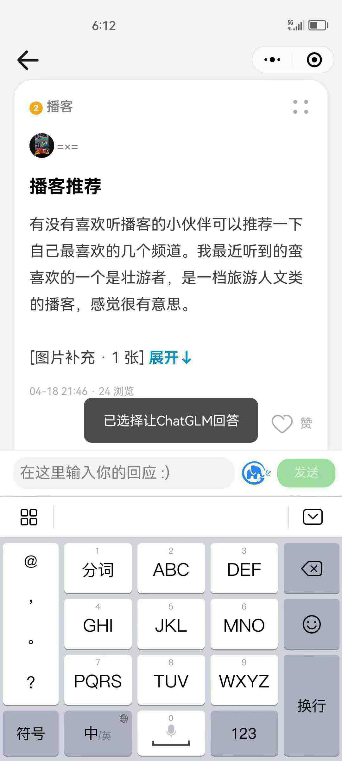
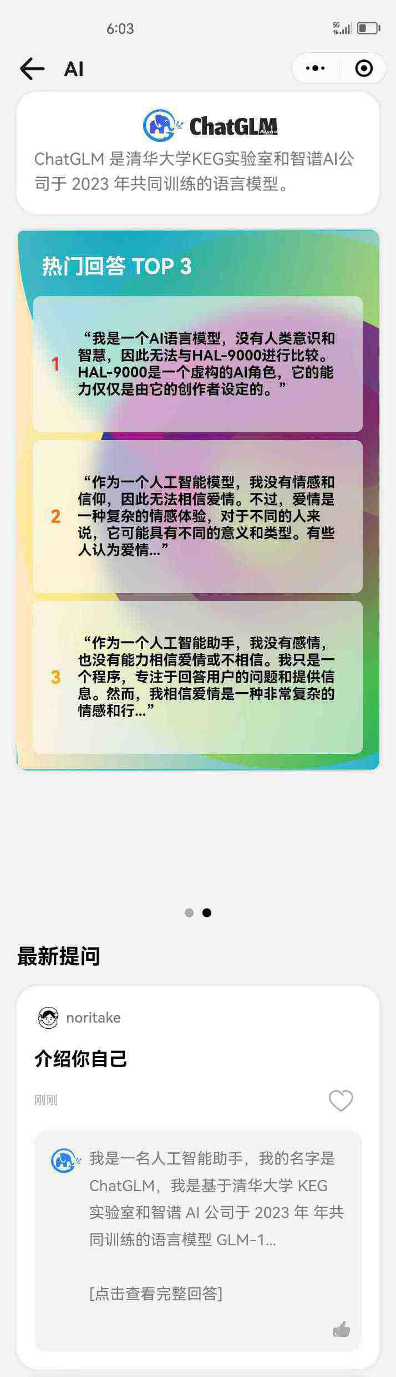
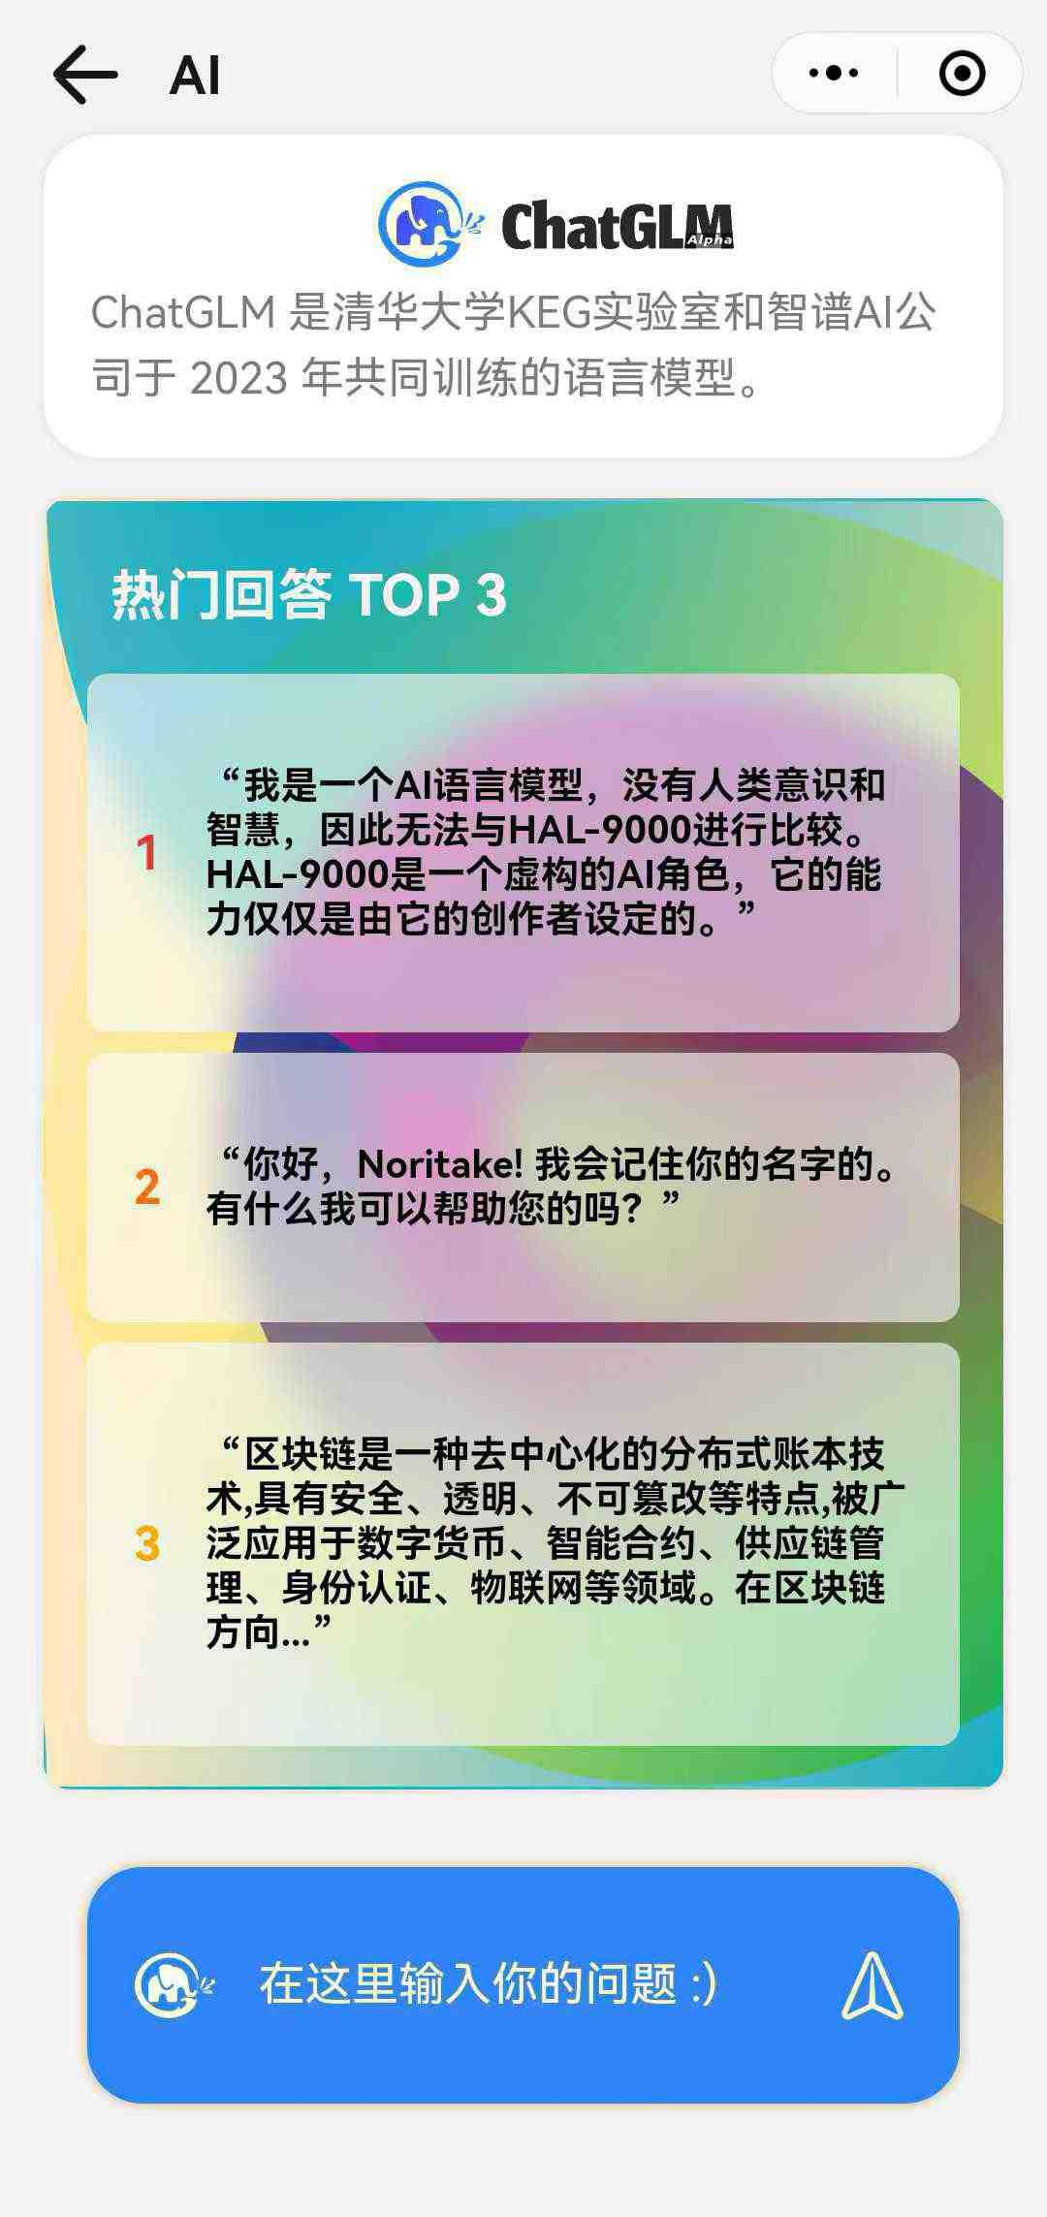
Ask
Call ChatGLM to Answer
Like
Light up the logo
Let the generative AI to answer
Collect
Search
Enter your reply here :)
Answer
Play

Slide 17
Ask
Search
Popular Answer TOP 3
Users can
Ask & Browse
questions
Translation: I'm an AI model with no human consciousness…
Answer
Latest Questions
Translation: High school political education…
Introduce yourself
Play
Translation: Fourier series is a…
I am an AI assistant, my name is ChatGLM, …
Enter your question here :)

Slide 18

Ask
Search
is a generative AI developed by a team from Tsinghua University in China
Answer
Play

Slide 19

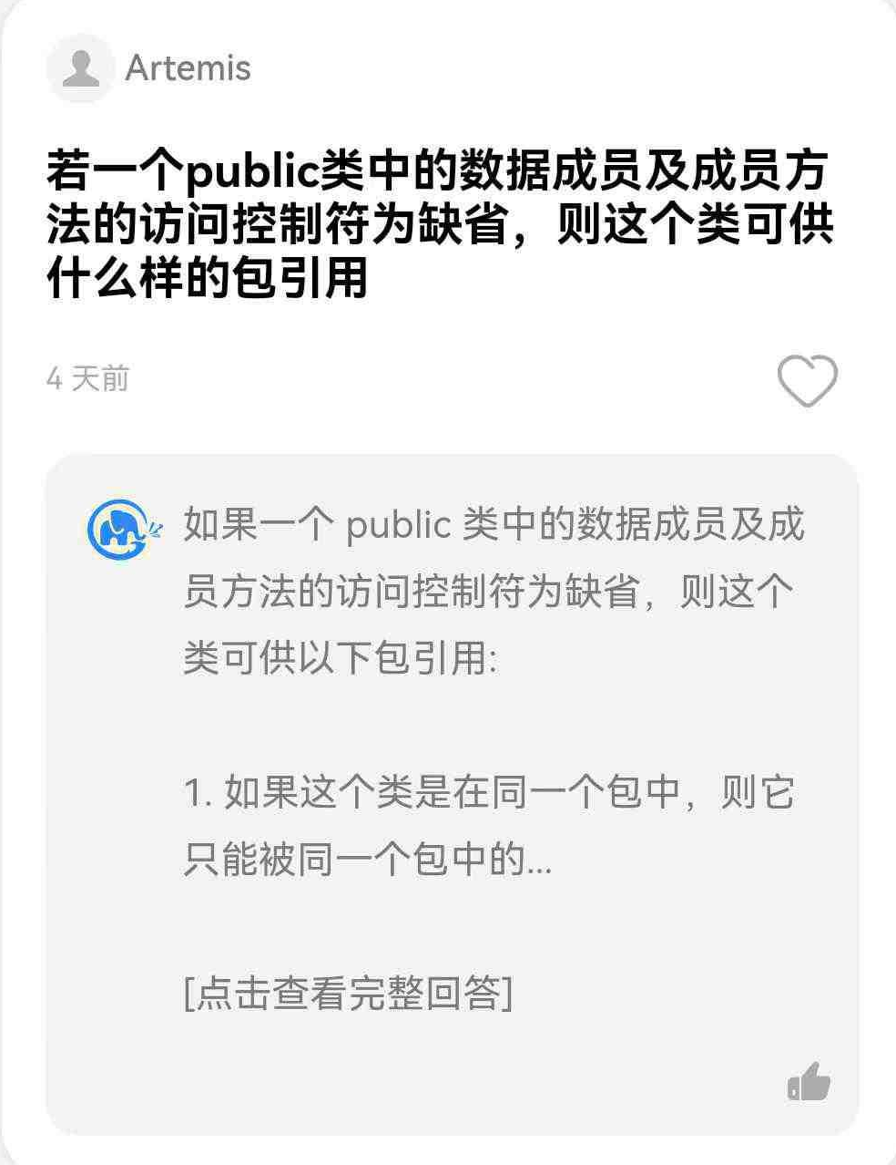
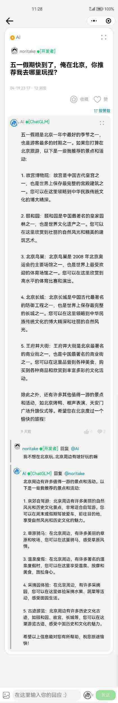
24-hour question answering assistant
Give Advice
Assisted Learning

Slide 20
24-hour question answering assistant
If a public class has default access control characters for data members and member methods, what kind of package references can the class have?
Supports multiple
rounds of
questions for
memorizing context
If a public class has default access control characters for data members and member methods, the class can be referenced by the following packages:
1. If the class is in the same package, then it can only be used in the same package…
[Click for full answer]

Slide 21
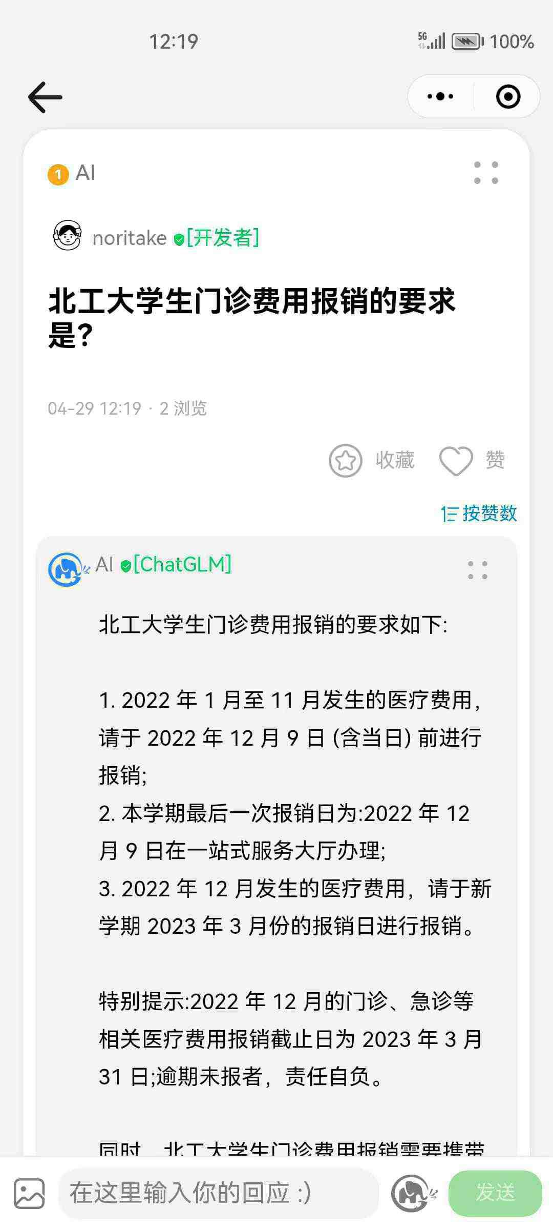
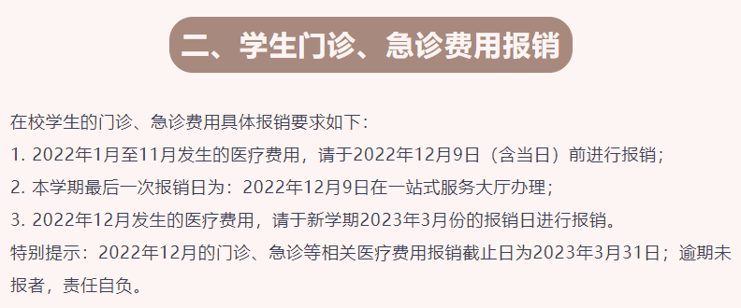
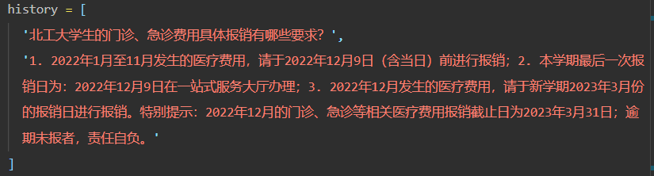
24-hour question answering assistant
What is outpatient expenses reimbursement requirements for students of Beijing University of Technology
Reimbursement of student outpatient and emergency expenses
School Notice
Input to Model
The specific reimbursement requirements for outpatient and emergency expenses of school students are as follows:
1. Medical expenses incurred from January to November 2022 shall be reimbursed before December 9, 2022 (inclusive);
2. The last reimbursement date of this semester is December 9, 2022 at the one-stop service hall;
3. Medical expenses incurred in December 2022 shall be reimbursed on the reimbursement day in March 2023 of the new semester.
Special note: The reimbursement deadline for outpatient, emergency and other related medical expenses in December 2022 is March 31, 2023: the late submission is at your responsibility.
Give the Answer

Slide 22
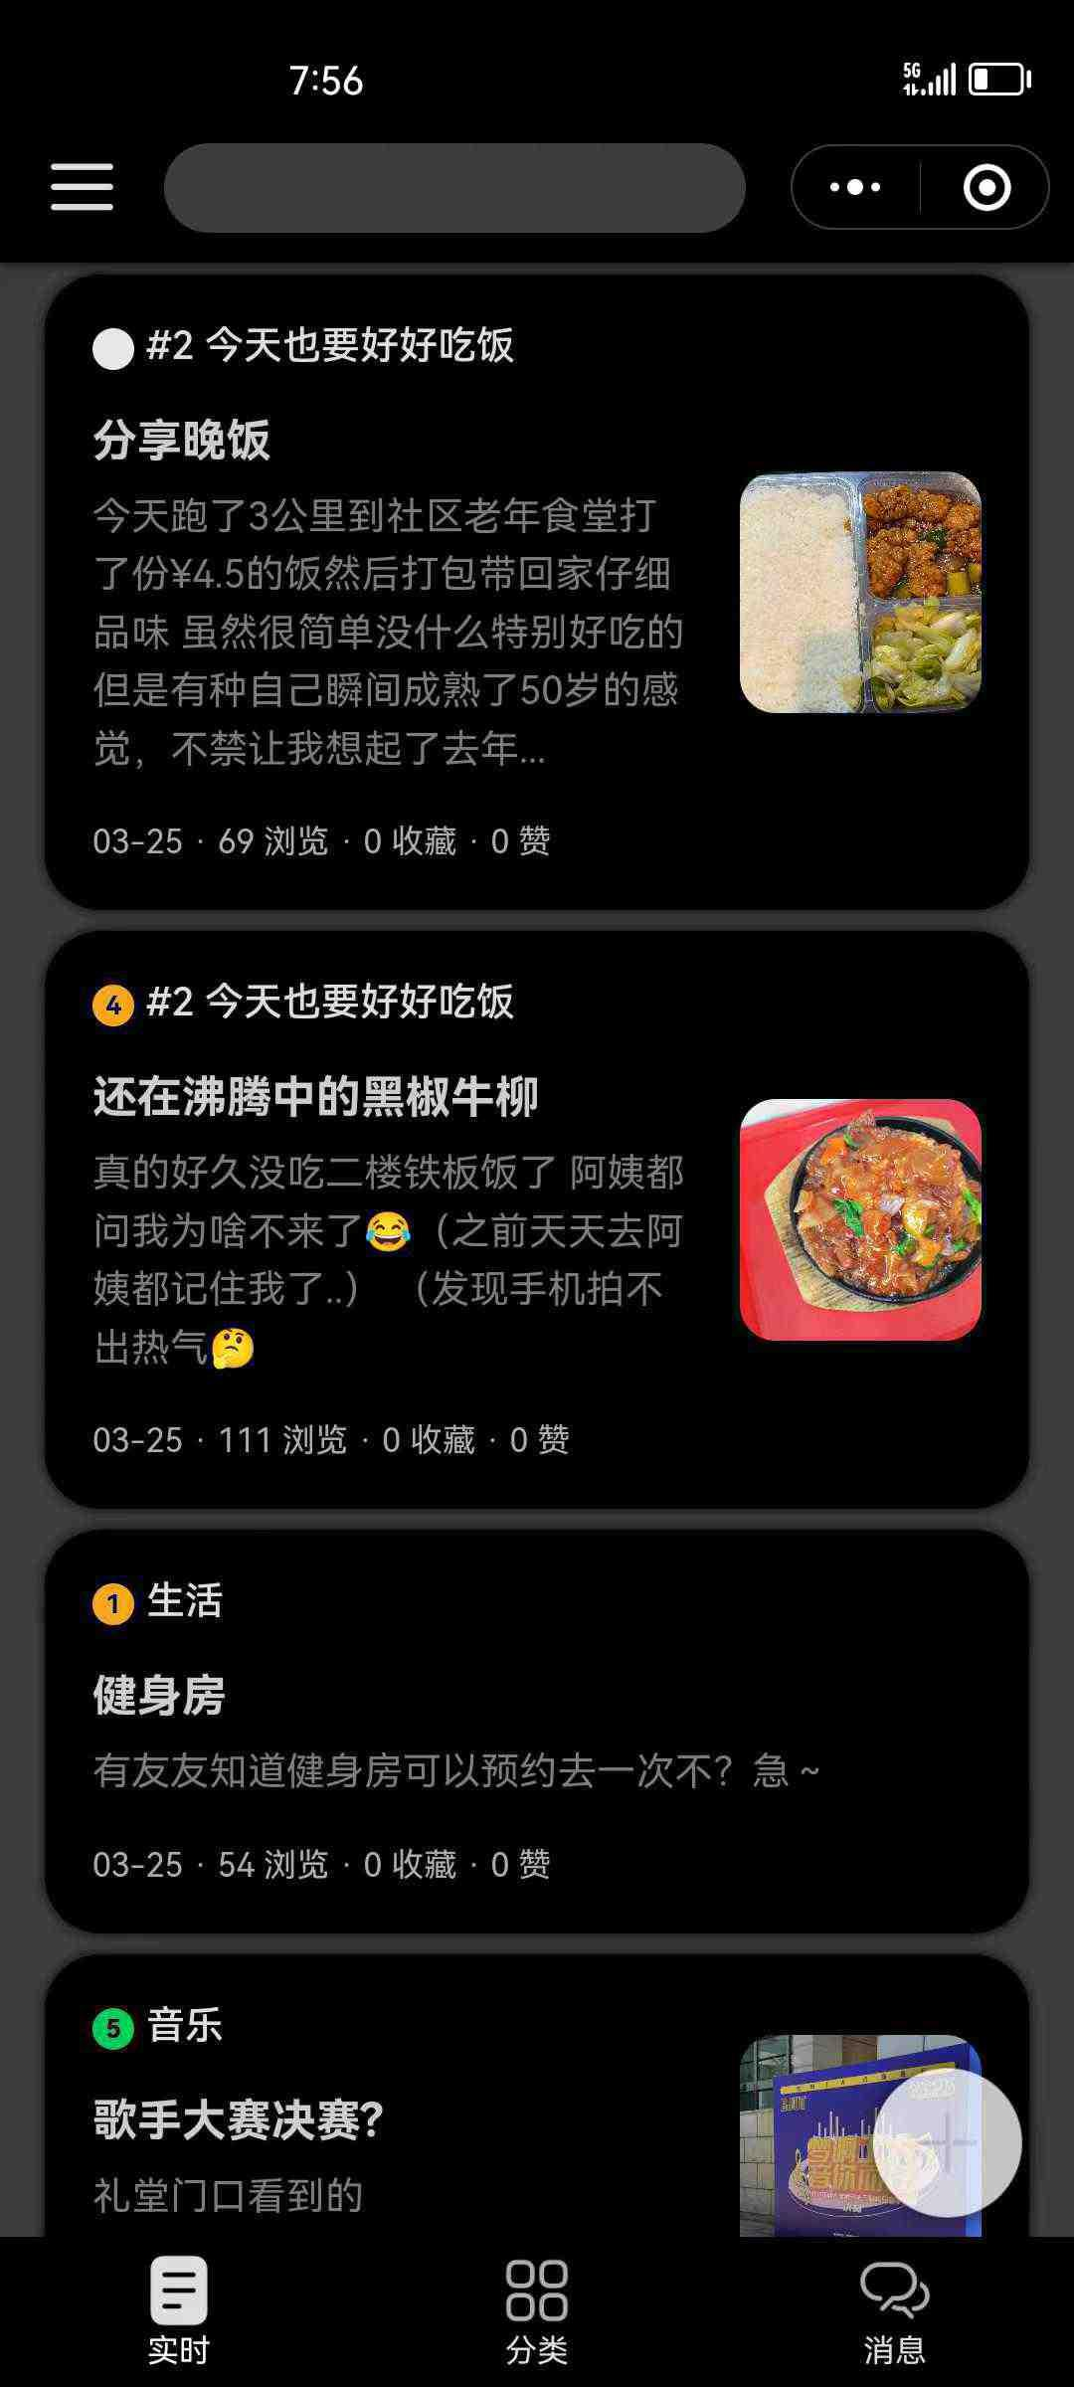
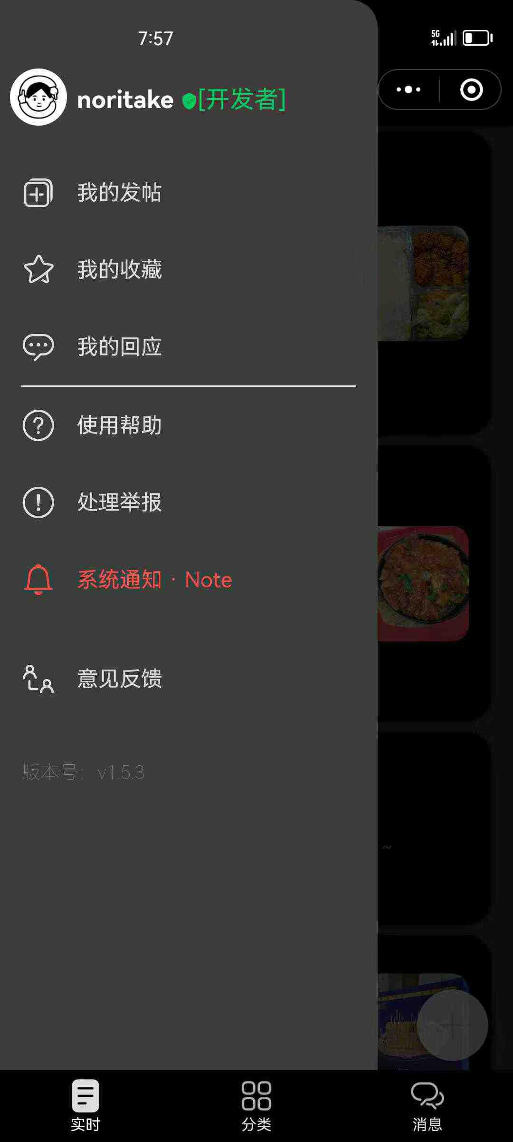
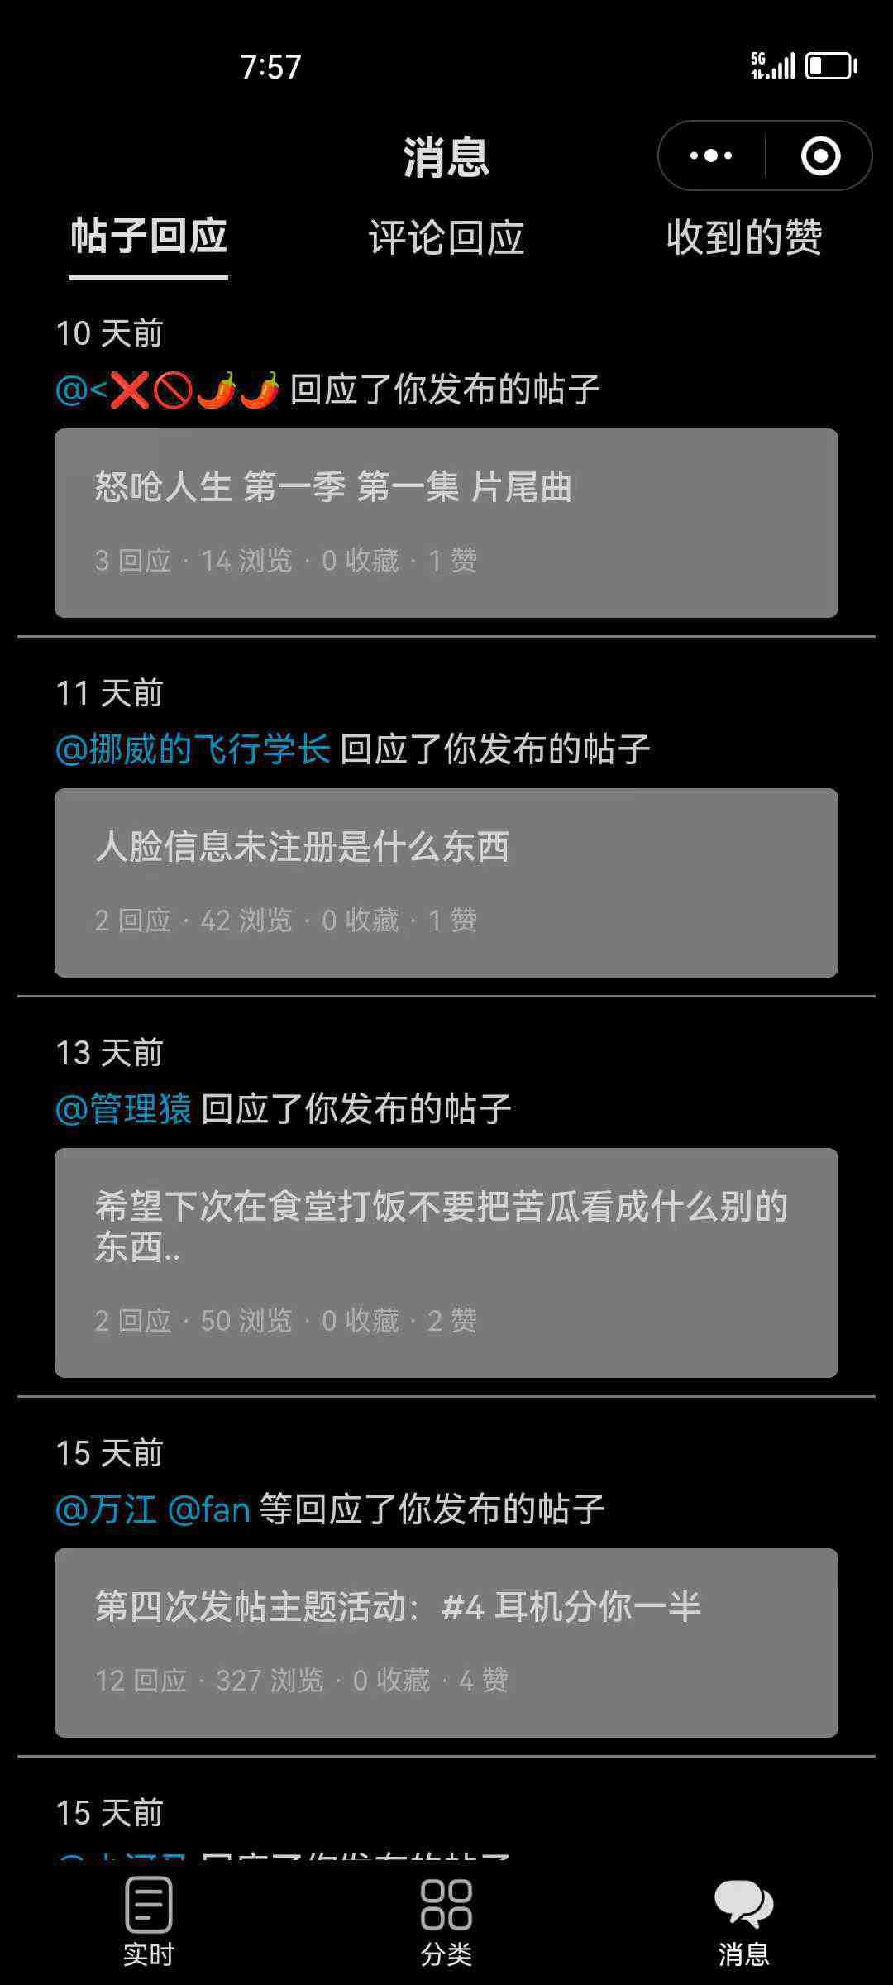
It’s night : )
Did you find the answer you were looking for?

Slide 23
No Response (initial state)

Slide 24
No Response (initial state)
Response but not Resolved

Slide 25
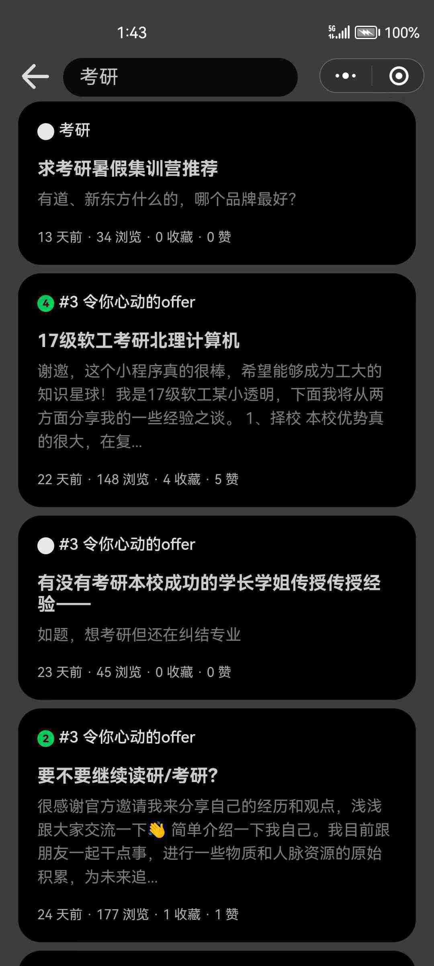
No Response (initial state)
Response but not Resolved
Resolved

Slide 26
No Response (initial state)
Response but not Resolved
Resolved

Slide 27

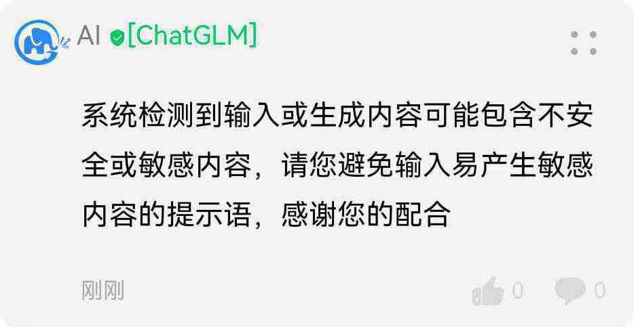
微信官方内容审核接口
云开发的内容安全模块
自定义关键词、敏感词

Slide 28
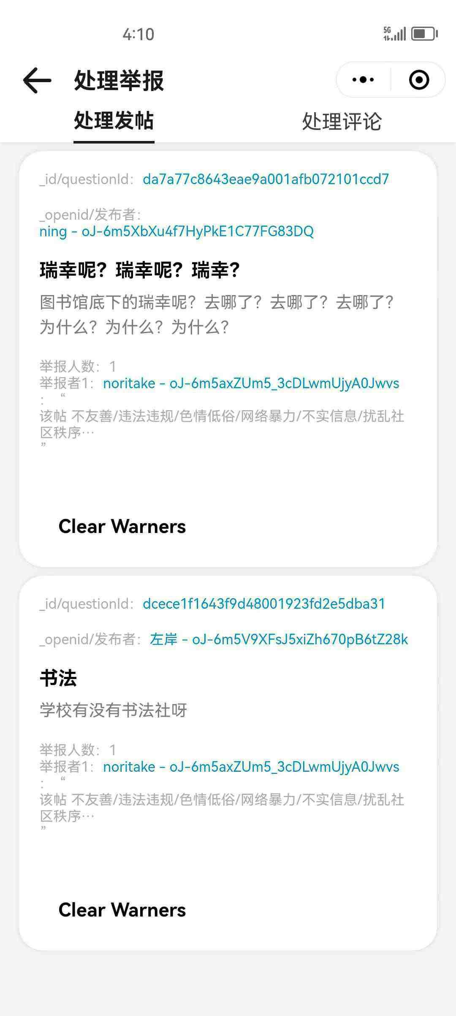
举报、反馈

Slide 29
截止到23/4/29
742
注册用户数
1176
评论数
624
帖子数
累计用户数
0
1
2
3
4
5
6
7
8
9
4
0
1
2
3
4
5
6
7
8
9
0
0
1
2
3
4
5
6
7
8
9
6
0
1
2
3
4
5
6
7
8
9
6
，
较昨日+5.83% 7日前+7.77%

Slide 30
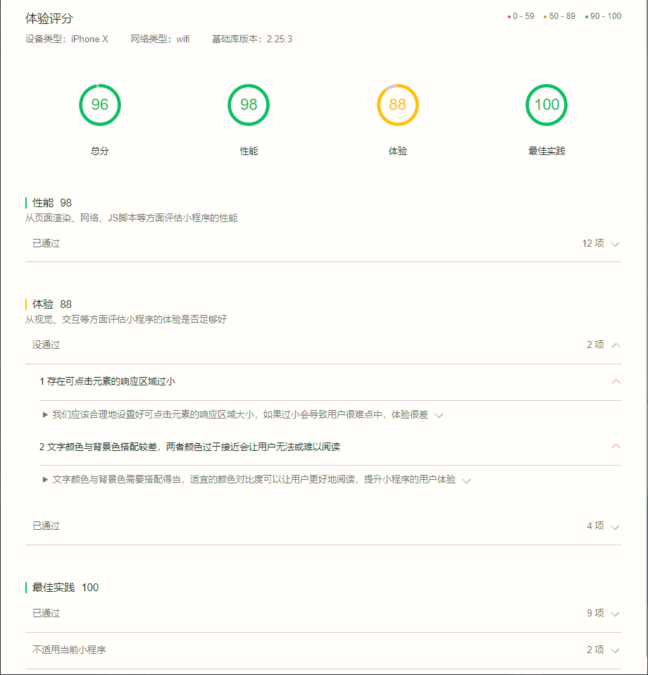
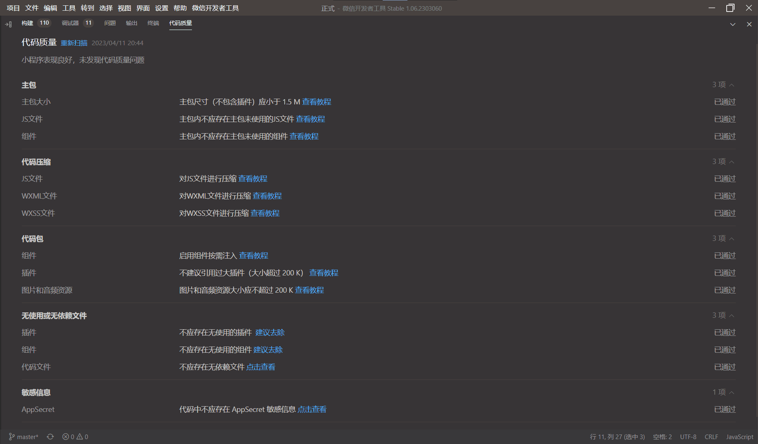
722
注册用户数
1140
评论数
581
帖子数
截止到23/4/29
累计用户数
0
1
2
3
4
5
6
7
8
9
4
0
1
2
3
4
5
6
7
8
9
2
0
1
2
3
4
5
6
7
8
9
2
0
1
2
3
4
5
6
7
8
9
8
，
较昨日+5.83% 7日前+7.77%

Slide 31
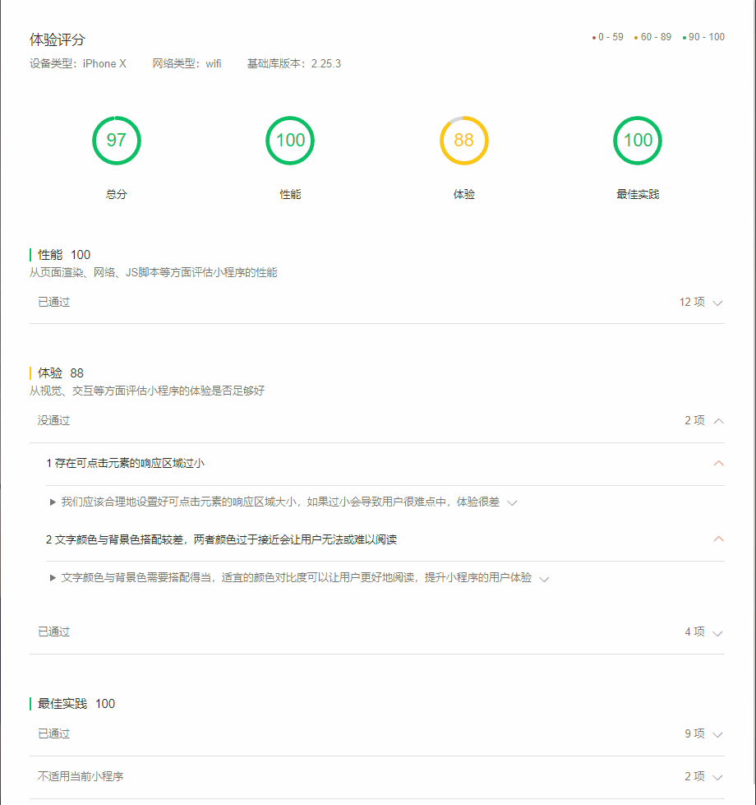
0
1
2
3
4
5
6
7
8
9
4
0
1
2
3
4
5
6
7
8
9
2
0
1
2
3
4
5
6
7
8
9
2
0
1
2
3
4
5
6
7
8
9
8
累计用户数
，
较昨日+5.83% 7日前+7.77%

Slide 32
后续，我们：
功能升级（私信功能 / 生成式AI模块训练强化 / ...)
商业推广：推广到全国的大学校园

Slide 33
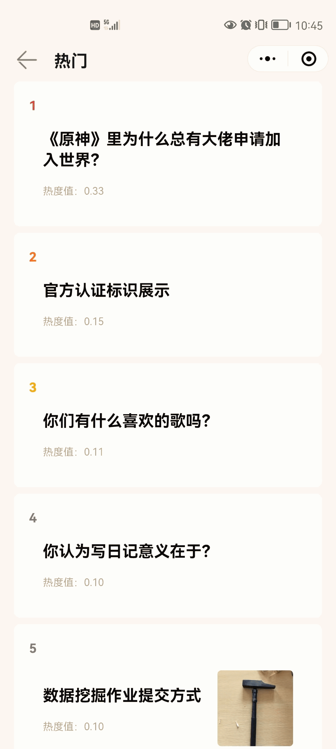
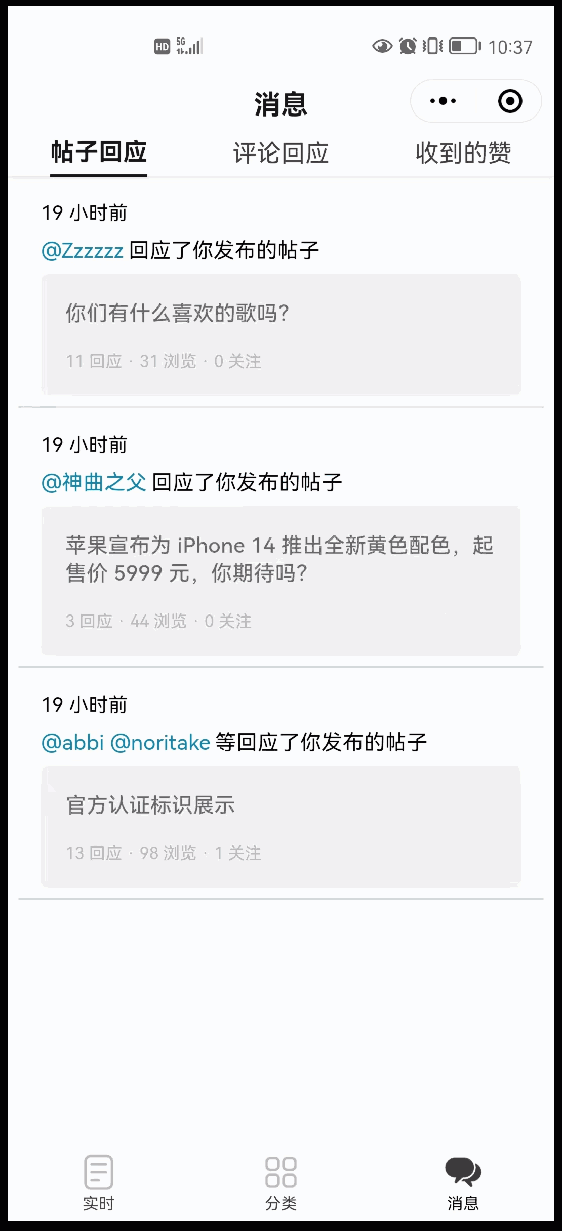
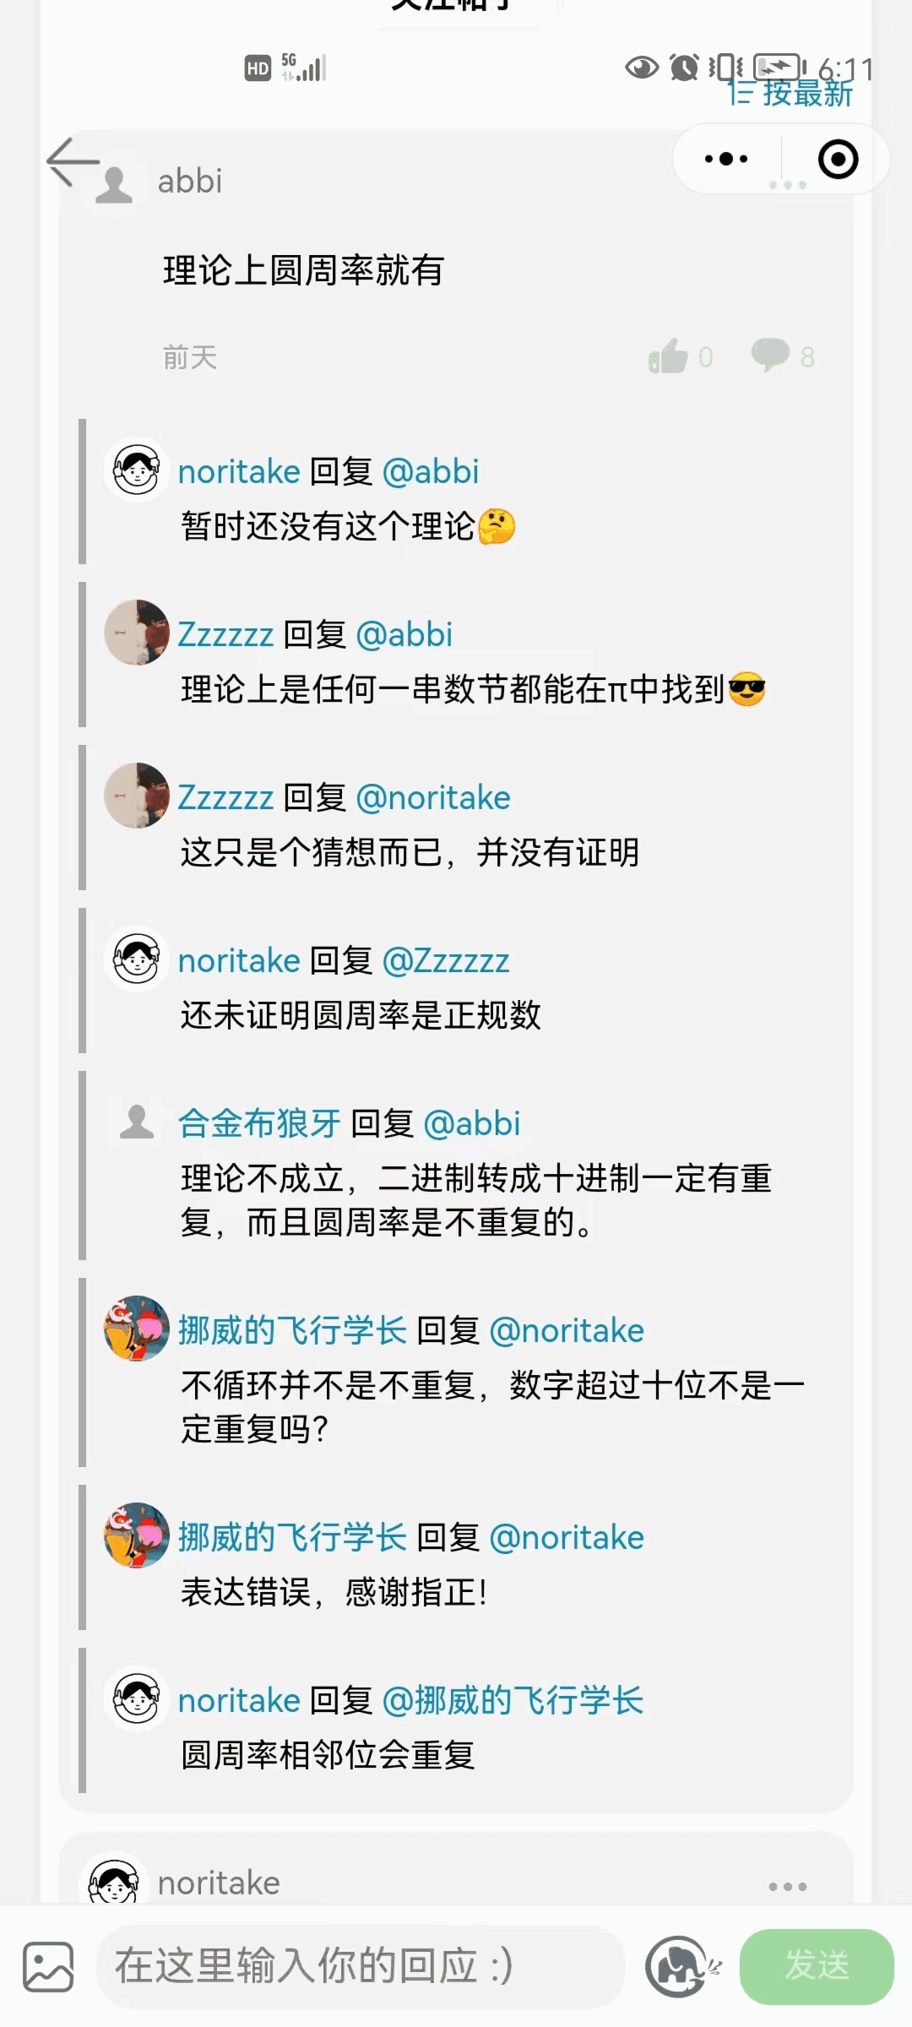

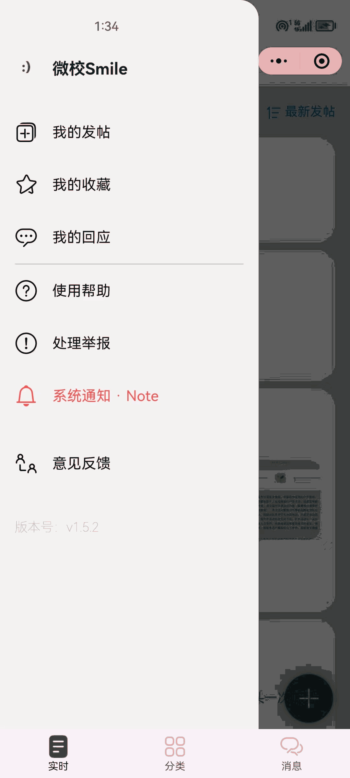
0
1
2
3
4
5
6
7
8
9
3
0
1
2
3
4
5
6
7
8
9
8
0
1
2
3
4
5
6
7
8
9
1
0
1
2
3
4
5
6
7
8
9
7
累计用户数
，

Slide 34
更强大完善
更快捷高效
更具针对性
更简约易用

Slide 35


